Slide 1
5G-MOBIX 2nd Webinar:
Presentation of the ES – PT Cross Border Corridor and preliminary findings
5G-infrastructure
Juan Francisco Esteban (Telefonica)
20 May 2020

Slide 2
Index
Network overview
MNOs interconnection
RAN deployment

Slide 3
Network overview

Slide 4
5G infrastructure
ES-PT CBC 5G Deployment
3GPP Deployment Option | Number of gNBs | Experimentation Frequency | MEC | Roaming
1st Phase - NSA Option 3x 2nd Phase - SA Option 2 (to be confirmed) | 8 | 4G - 1800 MHz (B3) 5G - 3.5 GHz (n78) | Distributed (Far edge & central) | HR/LBO
MEC deployment in order to accomplish with latency requirements, working as a Local Breakout of the traffic.
Multi-PLMN solution will be used in order to separate commercial traffic from trial traffic.
Roaming will be tested with Home Routing and Local Breakout procedures.
In total 8 gNB sites will be installed to cover the trial areas.

Slide 5



5G infrastructure
ES-PT CBC E2E Architecture
SPAIN
PORTUGAL
Internet
Madrid Lab Core
Braga Lab Core
SGi
SGi
S6a
S6a
P-GW
HSS
HSS
P-GW
S5
S6a
S8
S6a
S5
S8
S11
S10
S10
S11
Vigo MEC
SGi(LBO)
S-GW
MME
SGi(LBO)
IP/MPLS direct interconnection
Braga MEC
MME
S-GW
S1-C
S1-C
SPGW
vMEC
vMEC
S1-C
S1-U
S1-U
ITS Platform
S1-U
S1-C
S1-U
4G eNB
5G gNB
4G eNB
5G gNB
5G NSA Option 3x
ETSI MEC deployed with distributed SGW with Local Breakout (SGW-LBO)

Slide 6
MNOs interconnection

Slide 7
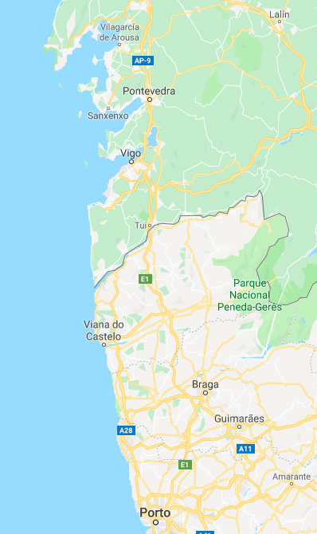



5G infrastructure
MNOs Interconnection options
Edge Interconnection
Centre Interconnection
GRX Provider
Not scalable the best Latency
Not so scalable but better Latency
Scalable but high Latency
To meet CCAM requirements MNOs must direct interconnect the edge nodes across the border

Slide 8
5G infrastructure
5G roaming scenarios
The two possibilities of roaming scenarios are going to be tested in order to clarify the best option for V2X services:
Each option has its own advantages and drawbacks:
It is foresee that Home Routing is the best solution for V2X services because the higher impact on the continuity is more critical than the lower impact on the latency.
Roaming option | Advantages | Drawbacks
Local Breakout | Is the optimum solution for latency reduction when an user is on the visited network Scalability | Service interruption during the transition (seconds)
Home routing | Continuity of the service is improved | Latency is increased proportionally to the distance towards the local network (~1ms/100km) Scalability

Slide 9
RAN deployment

Slide 10

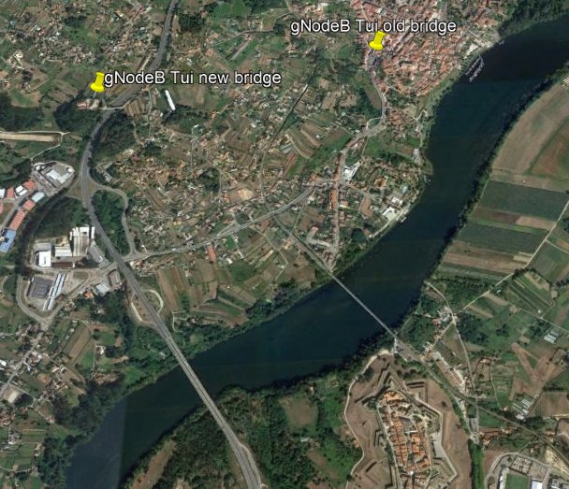
5G infrastructure
5G Radio Access Network
Two 5G nodes are going to be deployed in cross-border corridors.
  One of the will cover the A3 motorway over the new bridge (UC1, UC2 )
  The other one will cover the old train bridge (UC3)
The sites are going to be the actual 4G locations.
Macro Cells.
Spectrum – 5G NR on band n78 (3600 – 3800 MHz)

Slide 11

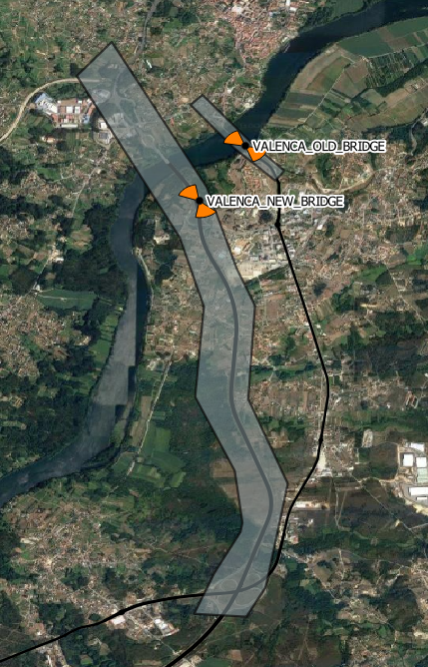
5G infrastructure
5G Radio Access Network.
SITE_NAME | SECTOR | TYPE | LATITUDE | LONGITUDE | AZIMUTH
VALENCA_NEW_BRIDGE | 1 | MACRO | 42.02939 | -8.65064 | 175
VALENCA_NEW_BRIDGE | 2 | MACRO | 42.02939 | -8.65064 | 330
VALENCA_OLD_BRIDGE_A | 1 | SMALL CELL | 42.03507 | -8.64525 | 80
VALENCA_OLD_BRIDGE_B | 1 | SMALL CELL | 42.03507 | -8.64525 | 260
Two new sites are going to be deployed in cross-border corridors
  An axial site that will cover the A3 motorway over the new bridge (UC1, UC2).
  Two small cells that will provide dedicated coverage on the old train bridge (UC3)
Spectrum – 5G NR on 3.7 GHz and 4G anchor on 1800 MHz
Backhaul – 10 Gbps P2P Fiber to IP WAN/MPLS
Sync – GNSS and PTP T-GM G.8275.1

Slide 12

5G infrastructure
Handover Area Adjustment
a3OffsetRsrpInterFreq
RSRP PT [dBm]
RSRP SP [dBm]
HO Area
a3TimeToTriggerRsrpInterFreq
The HO area will be initial adjusted by changing cell power and antenna electrical tilts.
Fine tuning of HO area through adjustment of A3 event offset and time to trigger.

Slide 13
Thank you

