Slide 1
5G-MOBIX 3rd Webinar
Network Architecture of the GR – TR Cross Border Corridor
Ioannis Masmanidis (Ericsson) GR-TR Webinar, June 29th, 2020

Slide 2

Layout GR – TR Cross Border Corridor
Framework
5G Network Architecture
5G RAN DEPLOYMENT
GR-TR Webinar, June 29th 2020

Slide 3
GR – TR Cross Border Corridor Framework

Slide 4
GR – TR Cross Border Corridor Framework
Functional/Non-Functional
Cross Border Sustainability
Feasibility for commercial deployment
Trial Horizon: 2020->2021
Flexible & Scalable Infrastructure
Roaming Architecture
GRX/IPX/VPN MNO Interconnections with SLAs
Mobile Network Operators (MNO).
Communication Infrastructure Providers (CIP).
Authorities/Policy Makers (APM).
Road Infrastructure Operators (RIO).
Original Equipment Manufacturers/Automobile Makers (OEM).
Software Developers (SWD).
GR-TR Webinar, June 29th 2020

Slide 5
GR – TR Cross Border Corridor 5G Network Architecture
Notes:
In addition, the selected architecture of the 5G-MOBIX GR-TR cross-border corridor, described in this deliverable, could be the basis of the distributed core architecture solution of COSMOTE network, and consequently the Deliverable D2.2 could be a useful Architecture Blueprint. Specifically, for the 5G-MOBIX GR-TR cross-border corridor trial, COSMOTE’s production site at Alexandroupoli (CO-like), where the overlay 5G EPC is planned to be deployed, must be upgraded to a core edge Data Centre (DC) site, resulting in the first core edge DC at COSMOTE network with strict requirements in terms of low latency & availability.
Finally, it is envisaged that the designed solution, which is aimed to be future-proof and scalable, can serve as a stepping stone for COSMOTE to conduct business feasibility studies within Deutsche Telekom Group
Deployment Option-3
• Option 3 (Figure 12) is based on overlay dedicated networks where all signalling and user plane traffic are
carried out via a direct interconnection link. This results in significantly reduced latency for both UP and
CP traffic.
• This option is easier to deploy from an operator point of view, as interfacing to commercial network may
be optional or conditional.
• This option raises scalability concerns for wide deployments, which may be overcome based on 5GC
technologies and upcoming releases of 5G.
The networks experts (MNOs and vendors) of both the ES-PT and GR-TR cross-border corridors have agreed that the only viable option for 5G network interconnection which could support the advanced 5G-MOBIX UCCs is deployment option 3, as the involvement of the GRX at any stage of the architecture would introduce unacceptable latency when crossing the border and would hence not be able to support the necessary CCAM functionality. Therefore, Deployment Option 3 is the 5G-MOBIX common architecture,
which will act as the basis for the 5G network deployments in the ES-PT and GR-TR corridors.
COSMOTE, through the active participation of the responsible departments in the 5G-MOBIX GR-TR crossborder corridor trial, will have gained technical expertise in launching services with strict requirements in terms of low latency & reliability from the design/planning phase up to the operational one. For instance, given that the 5G-MOBIX GR-TR cross-corridor trial is expected to use 5G NR spectrum at the 3.5GHz frequency band, a key strategic frequency band for 5G deployments, in collaboration with COSMOTE’s licensed LTE spectrum at 2.6GHz band, acting as LTE anchor layer in 5G NSA case, will allow COSMOTE RF planning & optimization teams to gain significant know-how on radio resources’ utilization and possible
interference issues that might arise. Furthermore, apart from gaining technical experience, COSMOTE willhave the chance to evaluate the suitability of existing roaming model for those use case categories in scope of the 5G-MOBIX GR-TR cross-border corridor trial.

Slide 6

GR – TR Cross Border Corridor Architectural Choices
Non-Standalone | VS | Standalone
Home Routed |  | Local Breakout
GRX Network |  | Direct connection
5G NSA Option3 Architecture
Overlay Packet Core/RAN deployment
EDGE Deployment based on Virtualized Distributed EPC Architecture
Direct EDGE interconnection
Home Routed Roaming with Session Continuity (Opt. LBO)
S10, Release with Redirect, S1 Handover
GR-TR Webinar, June 29th 2020

Slide 7

Network Overview GR-TR CBC E2E Architecture
Alexandroupolis Edge
Kartal Edge
Distributed virtualized 5G EPC
Distributed virtualized 5G EPC
MCCMNC 28601
MCCMNC 20201
Prov. GW
PCRF
PCRF
Prov. GW
CUDB
CNOM
CNOM
CUDB
HSS
S6a → TR PLMN MME
GR PLMN MME <- S6a
HSS
R
BGW
R
BGW
TR PLMN HSS <- S6a TR PLMN MME <- S10
S6a → TR PLMN HSS
S10 → TR PLMN MME
S6a
S6a
MME
S8 → TR PLMN PGW
10Gbps Ethernet DWDM
TR PLMN PGW <- S8
MME
S1-C
Cloud Platformsv
Cloud Platforms
S1-C
S11
SGi
SGi
S11
WINGS
WINGS
SGW
PGW
Edge Application
Edge Application
PGW
S1-C
SGW
S5
S5
S1-U
S1-U
eNodeB
X2-C
gNodeB
gNodeB
X2-C
eNodeB
X2- U
X2- U
(NSA – Opt. 3x)
(NSA – Opt. 3x)
Sensors Devices
UEs 5G OBU / Module
UEs 5G OBU / Module
Sensors Devices
GREECE
TURKEY
GR-TR Webinar, June 29th 2020

Slide 8
GR – TR Cross Border Corridor 5G RAN DEPLOYMENT

Slide 9
RAN ARCHITECTURE
5G EPC
Network architecture compliant to 3GPP R15 NSA, EN –DC, Option 3x
Overlay eNB/gNB for private V2X access
Anchoring of control plane traffic from or to the MME (S1-C) on eNB
Termination of user plane traffic from or to the SGW (S1-U) on eNB & gNB
Option 1
Option 3x
eNB
eNB/gNB
LTE commercial MBB service
Overlay LTE/NR private access to v2x service only
GR-TR Webinar, June 29th 2020

Slide 10
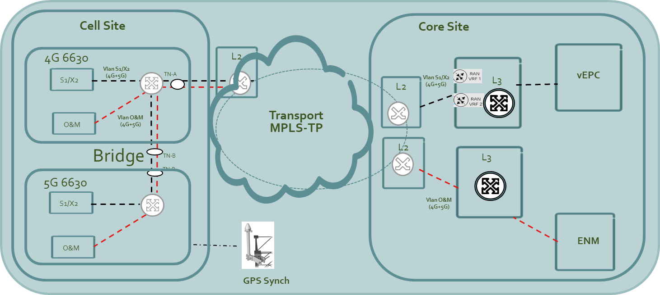

GR LTE and NR Air Interface Characteristics
1 x Physical Site
Overlay eNB/gNB carrier information
LTE B7 (2600) 20MHz, MIMO 2T2R, 40 w
NR n78F (3500-3600) MHz, MIMO 4T4R
TDD proposed frame structure: 4+2+4
GNSS based synchronization for 5G TDD
NR DL | NR UL
 | SR⁽¹⁾ based Scheduling | SPS⁽²⁾ based scheduling
3.5 ms | 11 ms | 6 ms
One-way DL and UL user plane latency
GR-TR Webinar, June 29th 2020

Slide 11
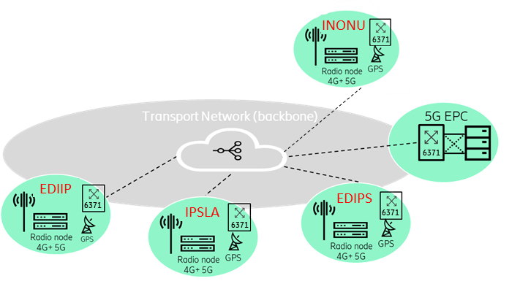
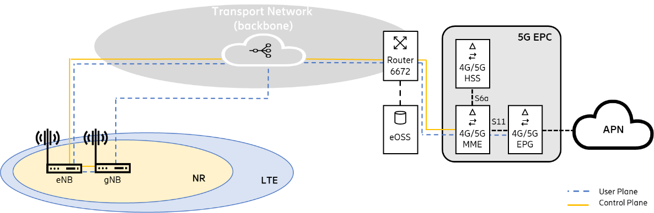
TR LTE and NR Air Interface Characteristics
4x Sites, NR NSA, Option 3x (band n78, in specific on B43 (3600-3800 MHz).
LTE B7 (2600) 20MHz, MIMO 2T2R, 40 w
NR n78F (3600-3800) MHz, MIMO 4T4R
GNSS based synchronization for 5G TDD
Carrier Aggregation
GR-TR Webinar, June 29th 2020

Slide 12
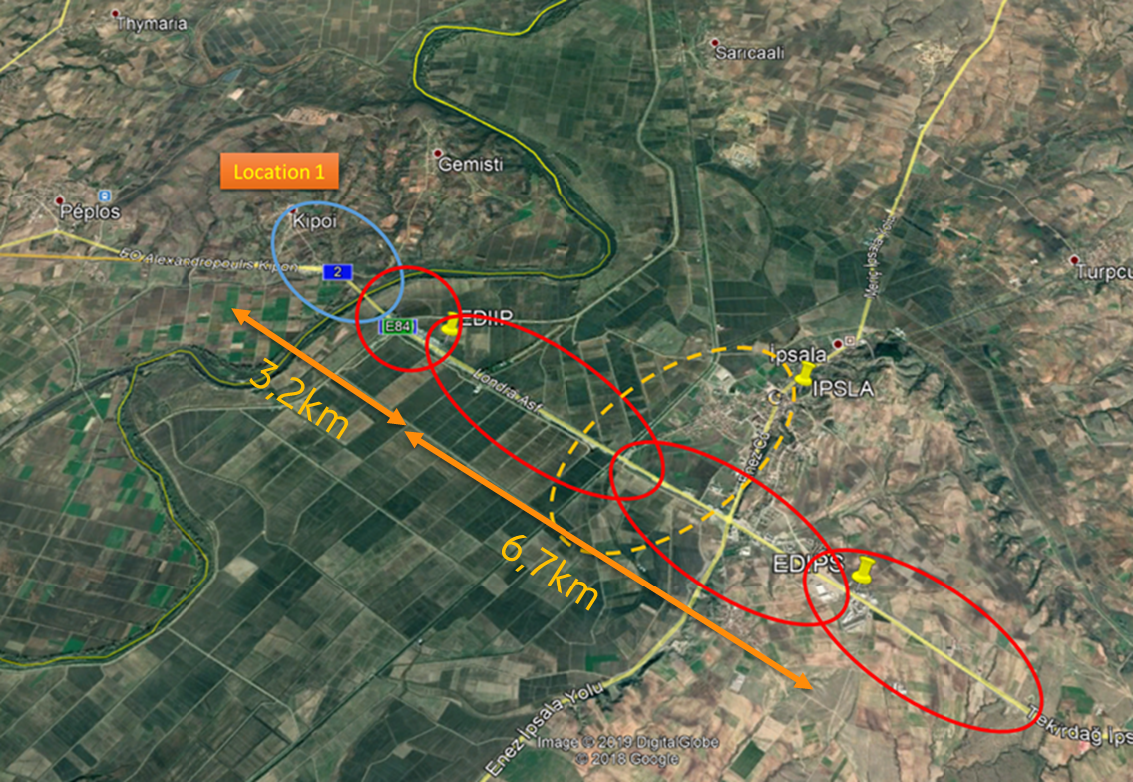
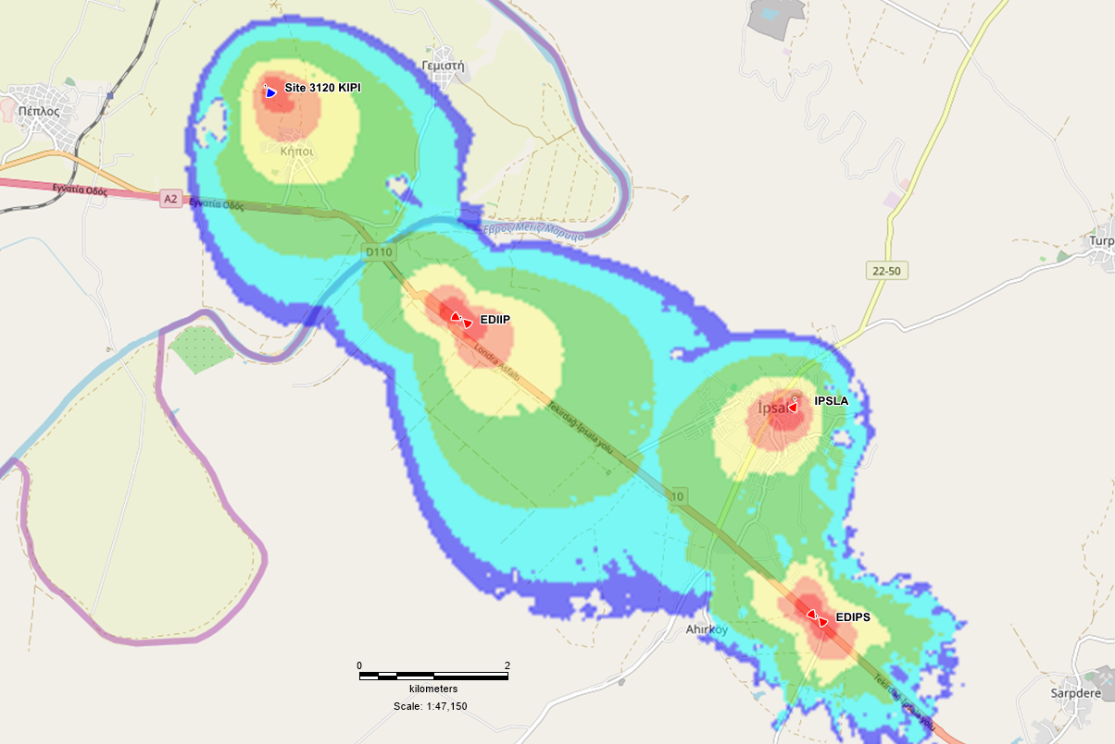
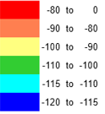
Cross-border Trial Location Site Locations
Ipsala (TR) – Kipoi (GR)
Coverage Predictions
GREECE
TURKEY
EDIIP
IPSLA
NR n78 100MHz SSRSRP
EDIPS
GR-TR Webinar, June 29th 2020

Slide 13
Thank you

