Slide 1
5G-MOBIX
5G for Cooperative, Connected and Automated Mobility

Slide 2


3-year H2020 project
Kick-off in November 2018
55 partners from 10 countries
ABOUT
Evaluate the benefits of 5G within the Cooperative Connected Automated Mobility (CCAM) context
Provide deployment scenarios
Contribute to standardization
OBJECTIVES
Develop and test automated vehicle functionalities using 5G core technological innovations
Run cross-border trials and evaluate
HOW
This project has received funding from the European Union’s Horizon 2020 research and innovation program under grant agreemen t no 825496.

Slide 3
5G-MOBIX Objectives
3
2
1
Formulate requirements for 5G/CCAM trials
Establish 5G/CCAM corridors to carry out trials
Trial, evaluate & validate 5G technologies for CCAM
Analyse cost/benefits in multi-operators domains
Explore and assess new business opportunities
Provide 5G deployment scenarios & recommendations including x-border context
Sustain standardisation and spectrum allocation
Scale up & replicate for global 5G/CCAM adoption
Deploy, test and evaluate 5G for CCAM
Run X-border trials to provide deployment scenarios
Contribute to SDA and 5G CEF preparation

Slide 4
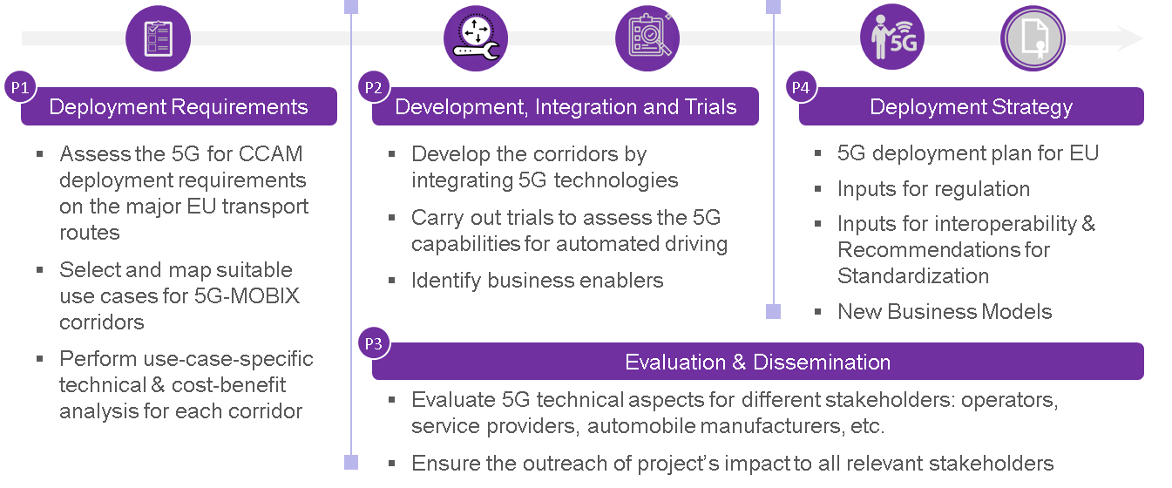
5G-MOBIX phases

Slide 5
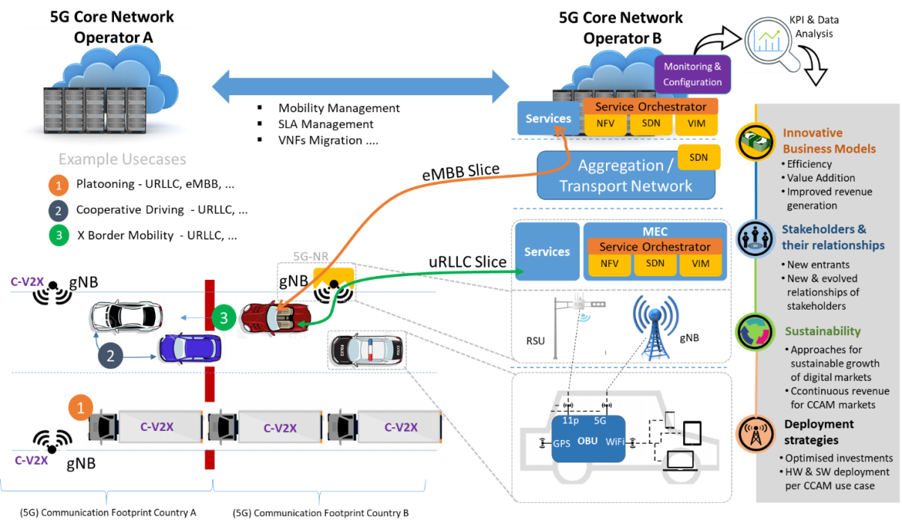
Overall concept and trial architecture
Trials through 2 network slices:
eMBB for high data throughputs
uRLLC for low latency connectivity
Local and cross-border trials with challenging Automated driving scenarios:
Cooperative manoeuver
Platooning

Slide 6
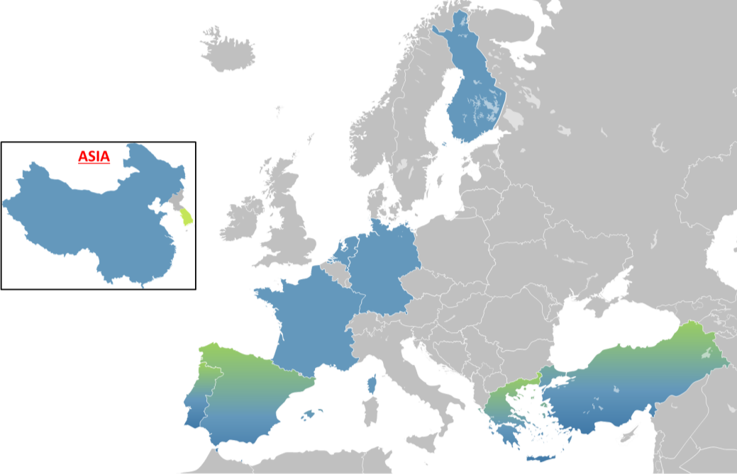
OVERVIEW OF 5G-MOBIX CBC / TS
2 Cross-Border Corridors (CBC)
4 complementary European Trial Sites (TS)
2 complementary Asian Trial Sites (TS)
5 Use case categories based on 3GPP TS 22.186
18 User stories
24 SAE L4 automated vehicles
30 5G gNBs
9 experimentation Frequency Bands

Slide 7



3GPP USE CASE CATEGORIES
1
2
3
4
5
Advanced
Driving
Vehicles
Platooning
Extended Sensors
Remote
Driving
Vehicle QoS
Support

Slide 8
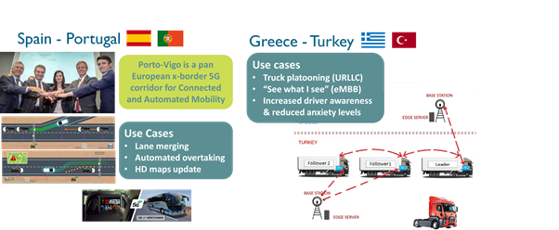
5G-MOBIX x-border corridors

Slide 9


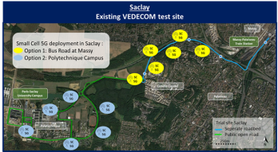




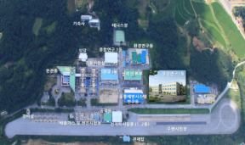
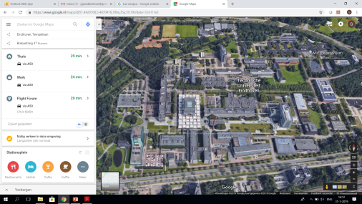




5G-MOBIX – Six local trial sites

Slide 10
CCAM scenarios over the trial sites
Trial site | Advanced Driving | Vehicles Platooning | Extended Sensors | Remote Driving | Vehicle QoS Support
ES-PT | Complex manoeuvres in cross-border settings |  | Extended sensors enabling complex manoeuvres | Automated shuttle remote driving across borders | Public transport with HD media services and video surveillance
GR-TR |  | Platooning with “see what I see” functionality in cross-border settings | Extended sensors for assisted border crossing
DE |  | eRSU-assisted Platooning | EDM-enabled extended sensors with surround view generation
FI |  |  | Extended sensors with redundant Edge processing | Remote driving in a redundant network environment
FR | Infrastructure-assisted advanced driving |  |  |  | QoS adaptation for security check in hybrid V2X environment
NL | Cooperative Collision Avoidance |  | Extended sensors with CPM messages | Remote driving using 5G positioning
CN | Cloud-assisted Advanced Driving | Cloud-assisted platooning |  | Remote driving with data ownership focus
KR |  |  |  | Remote driving over mmW | Tethering via Vehicle over mmW

Slide 11
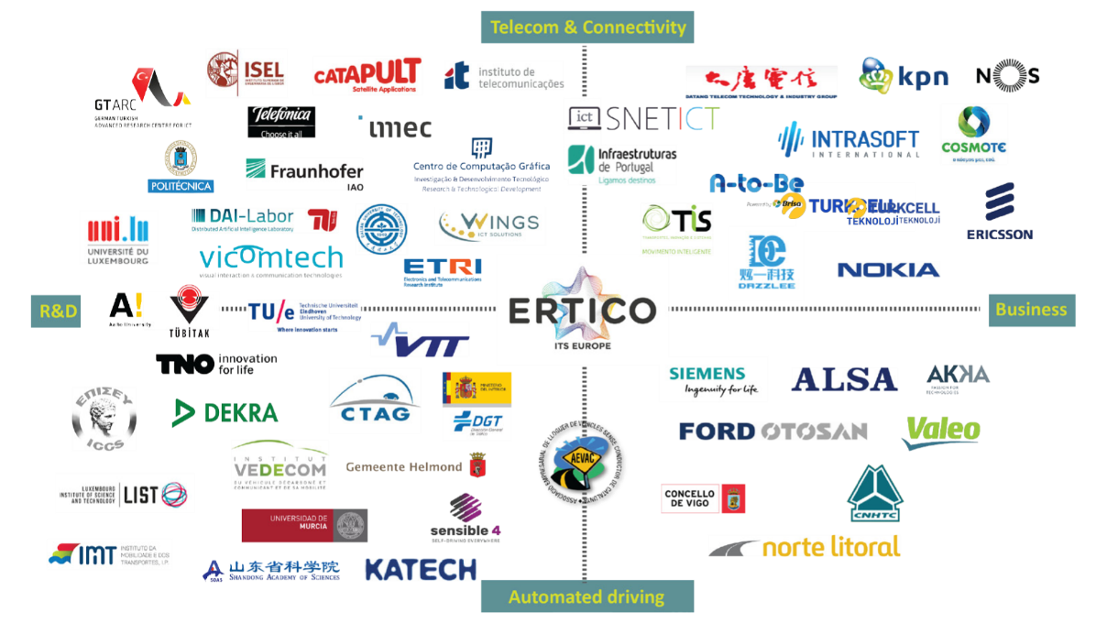

Slide 12
5G-MOBIX – project information
H2020 EU funded Innovation action
Call H2020-ICT-18-2018
Project costs: 27 m€ - EU funding: 21 m€
Start date 1 November 2018 – duration 36 months
5G- MOBIX Coordinator: ERTICO ITS Europe
5G-MOBIX is a ‘complementary grant’ to the following projects:
  ICT-17: 815074 5G EVE ; 815178 5GENESIS ; 815279 5G-VINNI
  ICT-18: 825012 5G-CARMEN ; 825050 5GCroCo
Web site: https://www.5g-mobix.com/

Slide 13

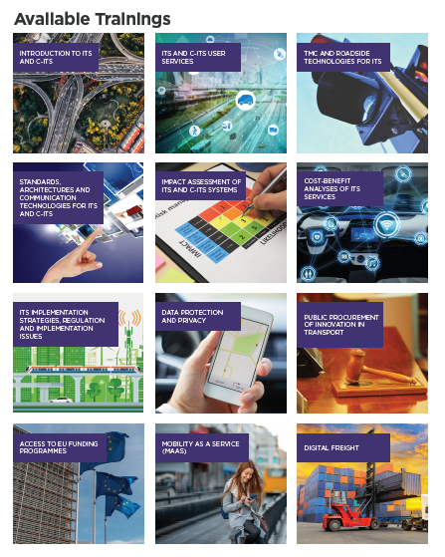



Training and capacity building
Filling the knowledge and experience gap for the deployment of ITS
    Training in smart and sustainable mobility – face to face & online
    Designed for Public Authorities in Europe & beyond
    On-demand & interactive courses for all levels
    ertico.com/academy

Slide 14
5G-MOBIX Coordinator contact:
Dr Nikolaos Tsampieris
Senior Manager Innovation & Development
ERTICO-ITS Europe
n.tsampieris@mail.ertico.com
Tel: +32 2 400 07 80

