Slide 1
5G MOBIX 2nd Webinar Presentation of ES-PT Cross-Border Corridor and preliminary findings
Technical Evaluation
CBC ES-PT May 20, 2020

Slide 2
Index
Overview
Preliminary results:
First test in ES side and ES-PT border
First test in PT side

Slide 3
Technical Evaluation Overview

Slide 4














Overview
T2.5
Initial evaluation KPIs and metrics
CCG
T3.5
Evaluation data collection & management
CCG
T5.1
Evaluation methodology and plans
T5.2
Technical Evaluation

Slide 5

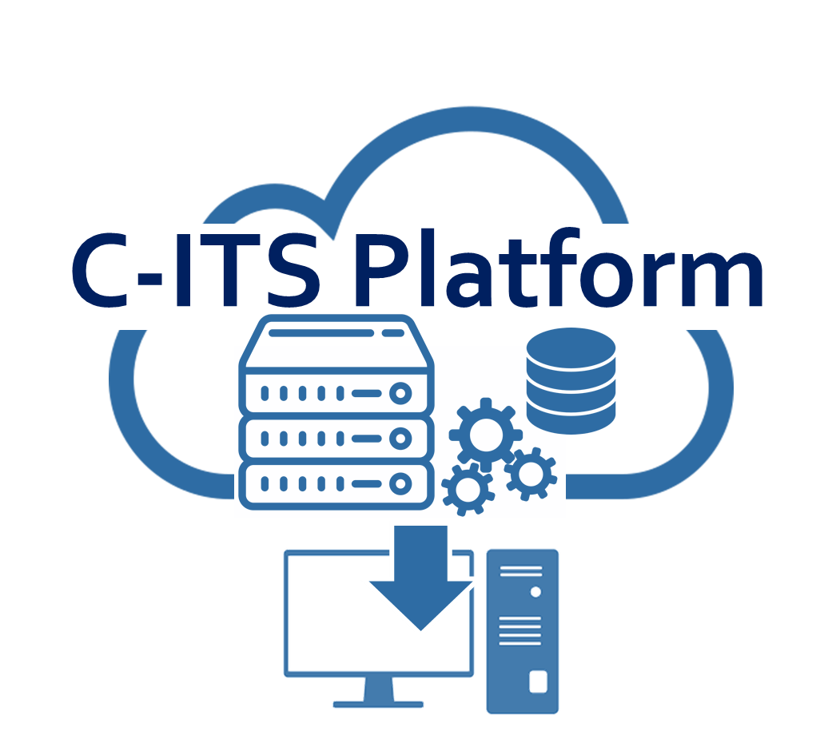
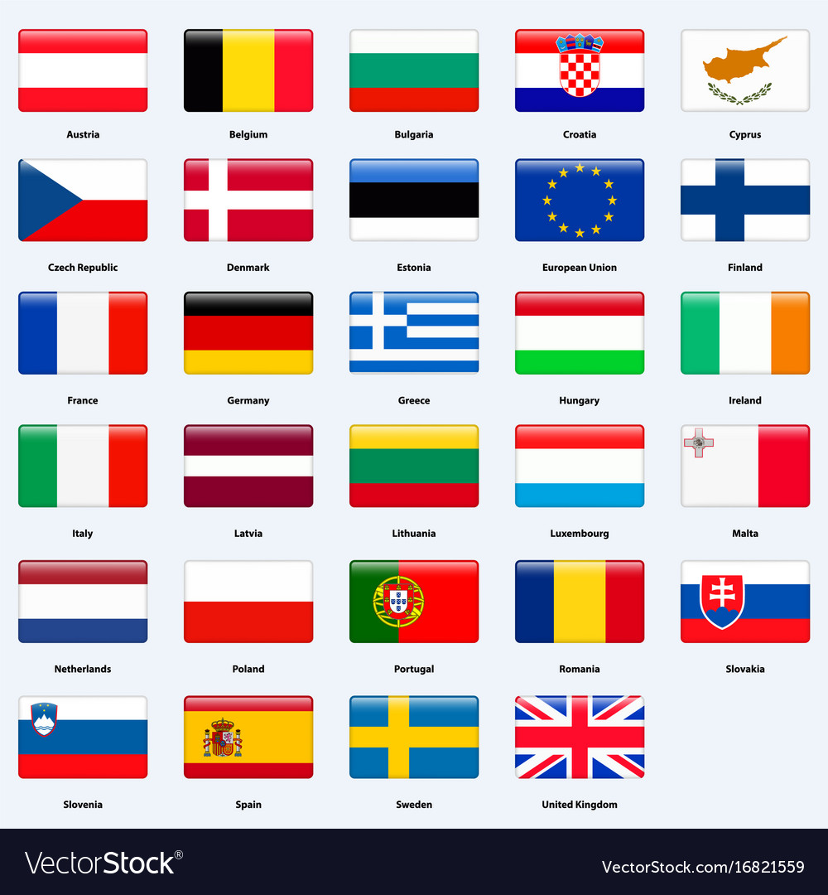



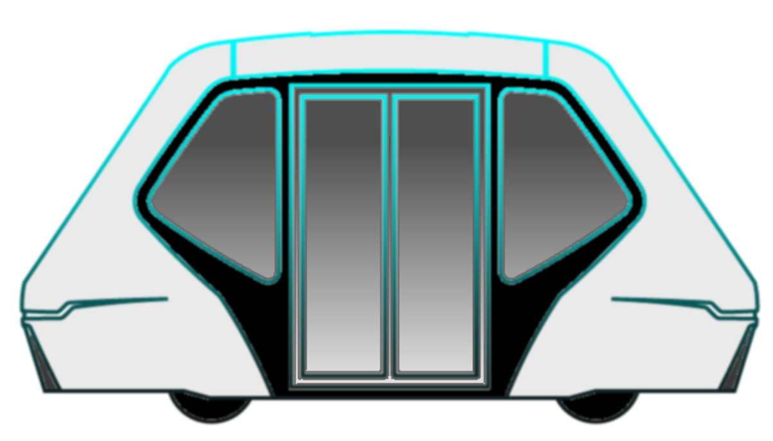




Data flows in Edge Infrastructure
Video Streaming
Control commands
CAM
CAM
MEC
MEC
ACK commands
Remote Driving Interface
Remote Driving Interface
Video Streaming
MQTT Broker
MQTT Broker
Control commands
ACK commands
DENM
CAM
CAM
CPM
DENM
CAM
DENM
CAM
CAM
CAM
CPM

Slide 6
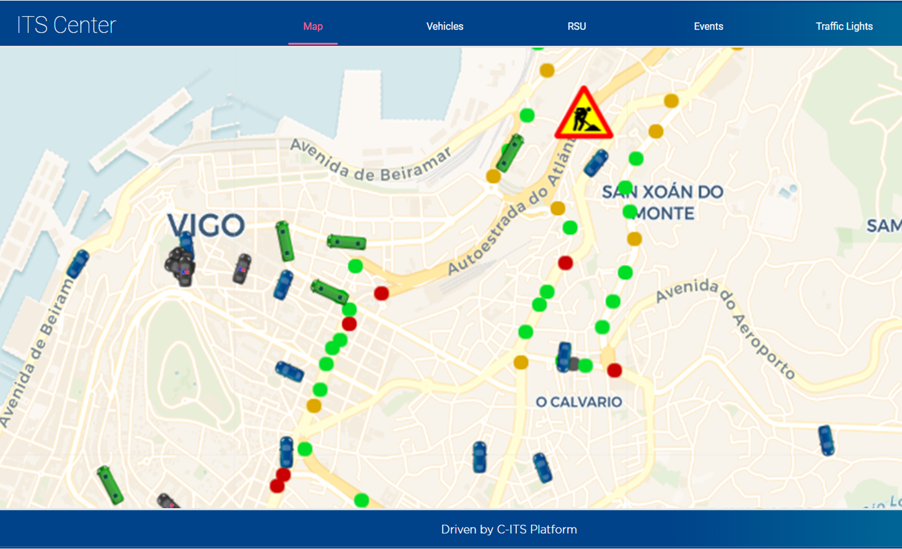

Data flows in Cloud Infrastructure
ITS Centre Platform
ITS Centre Platform
Traffic Management & Monitoring module
HD-map Processing module
HD-map Processing module
Traffic Management & Monitoring module
Map update (DB)
Map update (DB)
MEC
MEC
CAM
CAM
CAM
CAM
Raw sensor data
Raw sensor data
5G-MOBIX 2nd TR – 12th,13th December 2019 - Slide 6

Slide 7
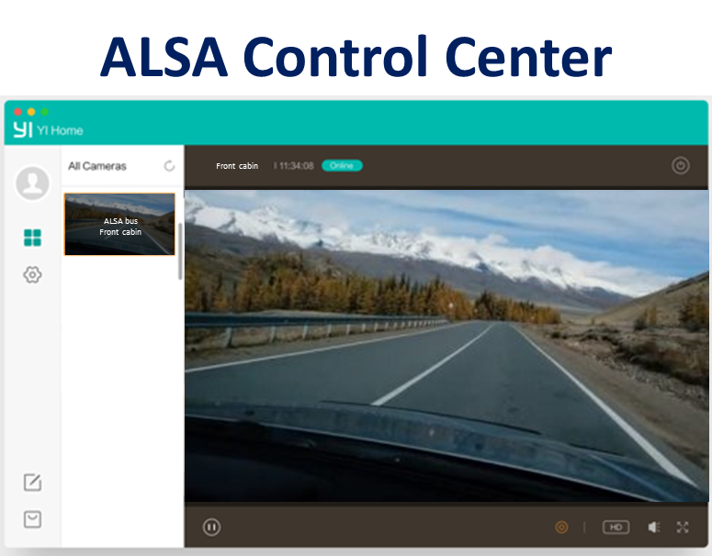




Data flows in Internet
Internet
Video streaming
Streaming request
5G-MOBIX 2nd TR – 12th,13th December 2019 - Slide 7

Slide 8



Extended Evaluations Advanced Driving
Description of the contribution | Provide an OBU connected to an intelligent router for testing different approaches in multi-PLMN roaming and handover scenarios.
Extended evaluation | Comparison between the change of network managed by the operators when one single SIM and the management in the OBU when two SIMs are available
Cross border issues addressed | TR1: NSA Roaming Latency TC1: Continuity Protocol
Description of the contribution | Compare the vehicle and infrastructure decision-making approaches. NL brings OBU (device and software) and MEC (software) to the CBC. During the manoeuvres, both ES-PT OBU and NL OBU log the performance in order to compare it later.
Extended evaluation | Comparison between in-vehicle or infrastructure decision-making approaches for Advanced Driving user stories.
Cross border issues addressed | AC1: V2X continuity AI1: Data Interoperability

Slide 9

Extended Evaluations
Description of the contribution | PLMN/MEC service discovery and migration protocol (SW asset) implemented: internal to the network: PT core external to the network: ES external MEC server
Extended evaluation | MEC working as a gateway, thus the service is limited to registration. At the time, interoperability between both implementations of the protocol is evaluated.
Cross border issues addressed | TC2. Performance continuity TS2. Edge service lifecycle AI2. Stack interoperability
Description of the contribution | Provide vehicles, MECs and RSUs in order to deploy their own user story “EDM-enabled extended sensors with surround view generation” within the “HD maps” scenario conditions
Extended evaluation | Deployment of the DE user story in new scenarios. Exploration of the interoperability between systems and networks in different countries. Compare results of ES-PT and DE deployments.
Cross border issues addressed | TR1. NSA Roaming Latency AC1. V2X Continuity TC1. Continuity Protocol AI1. Data Interoperability AP2. On demand Processing

Slide 10
Preliminary results in ES side and ES-PT border

Slide 11
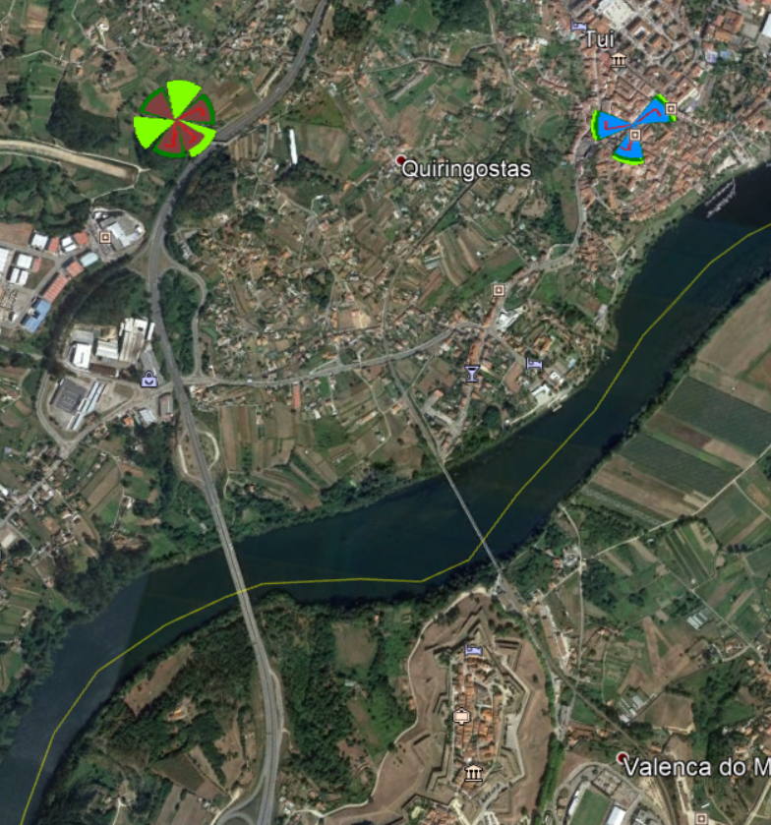
Preliminary results - Map
Map with sites (base stations) and bridges
As Bornetas
Tui-Centro
Old bridge
Administrative border
New bridge

Slide 12
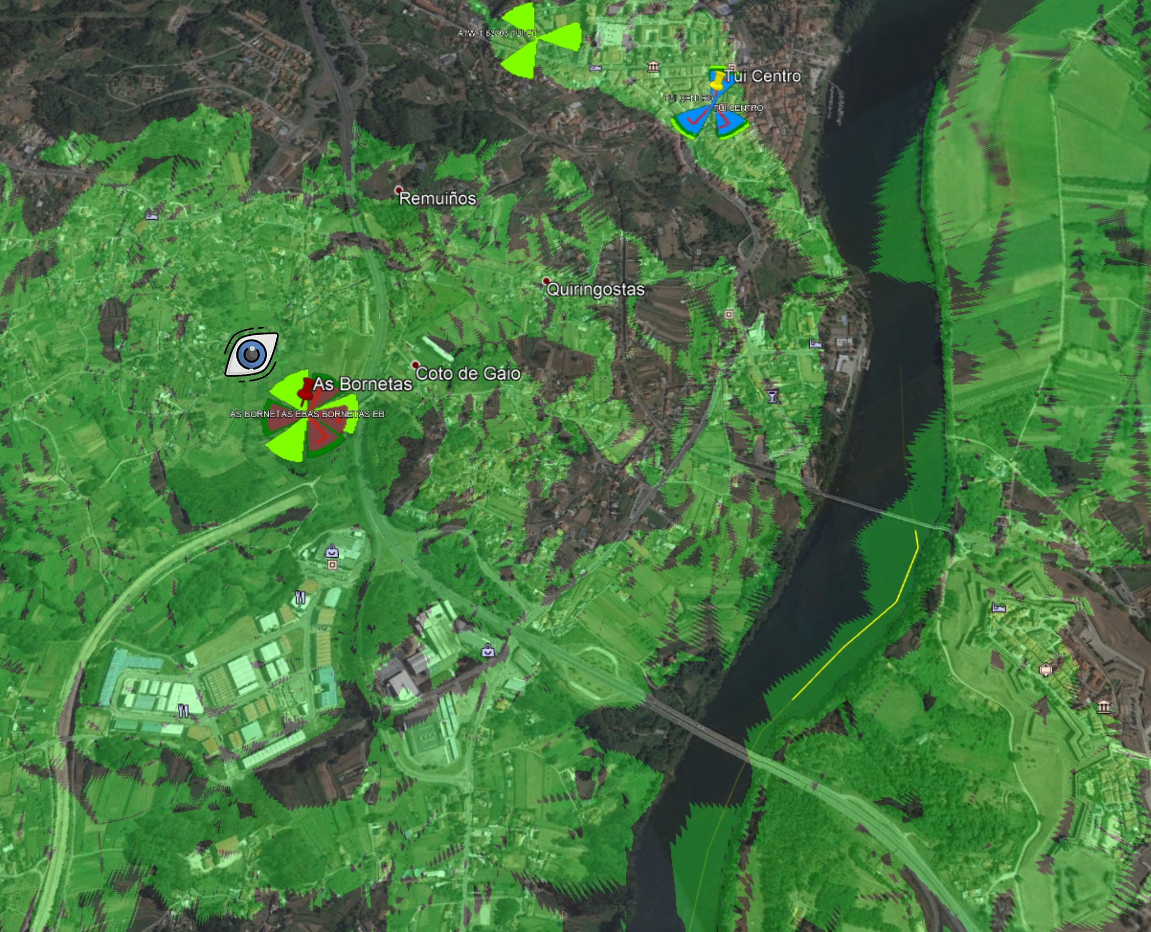
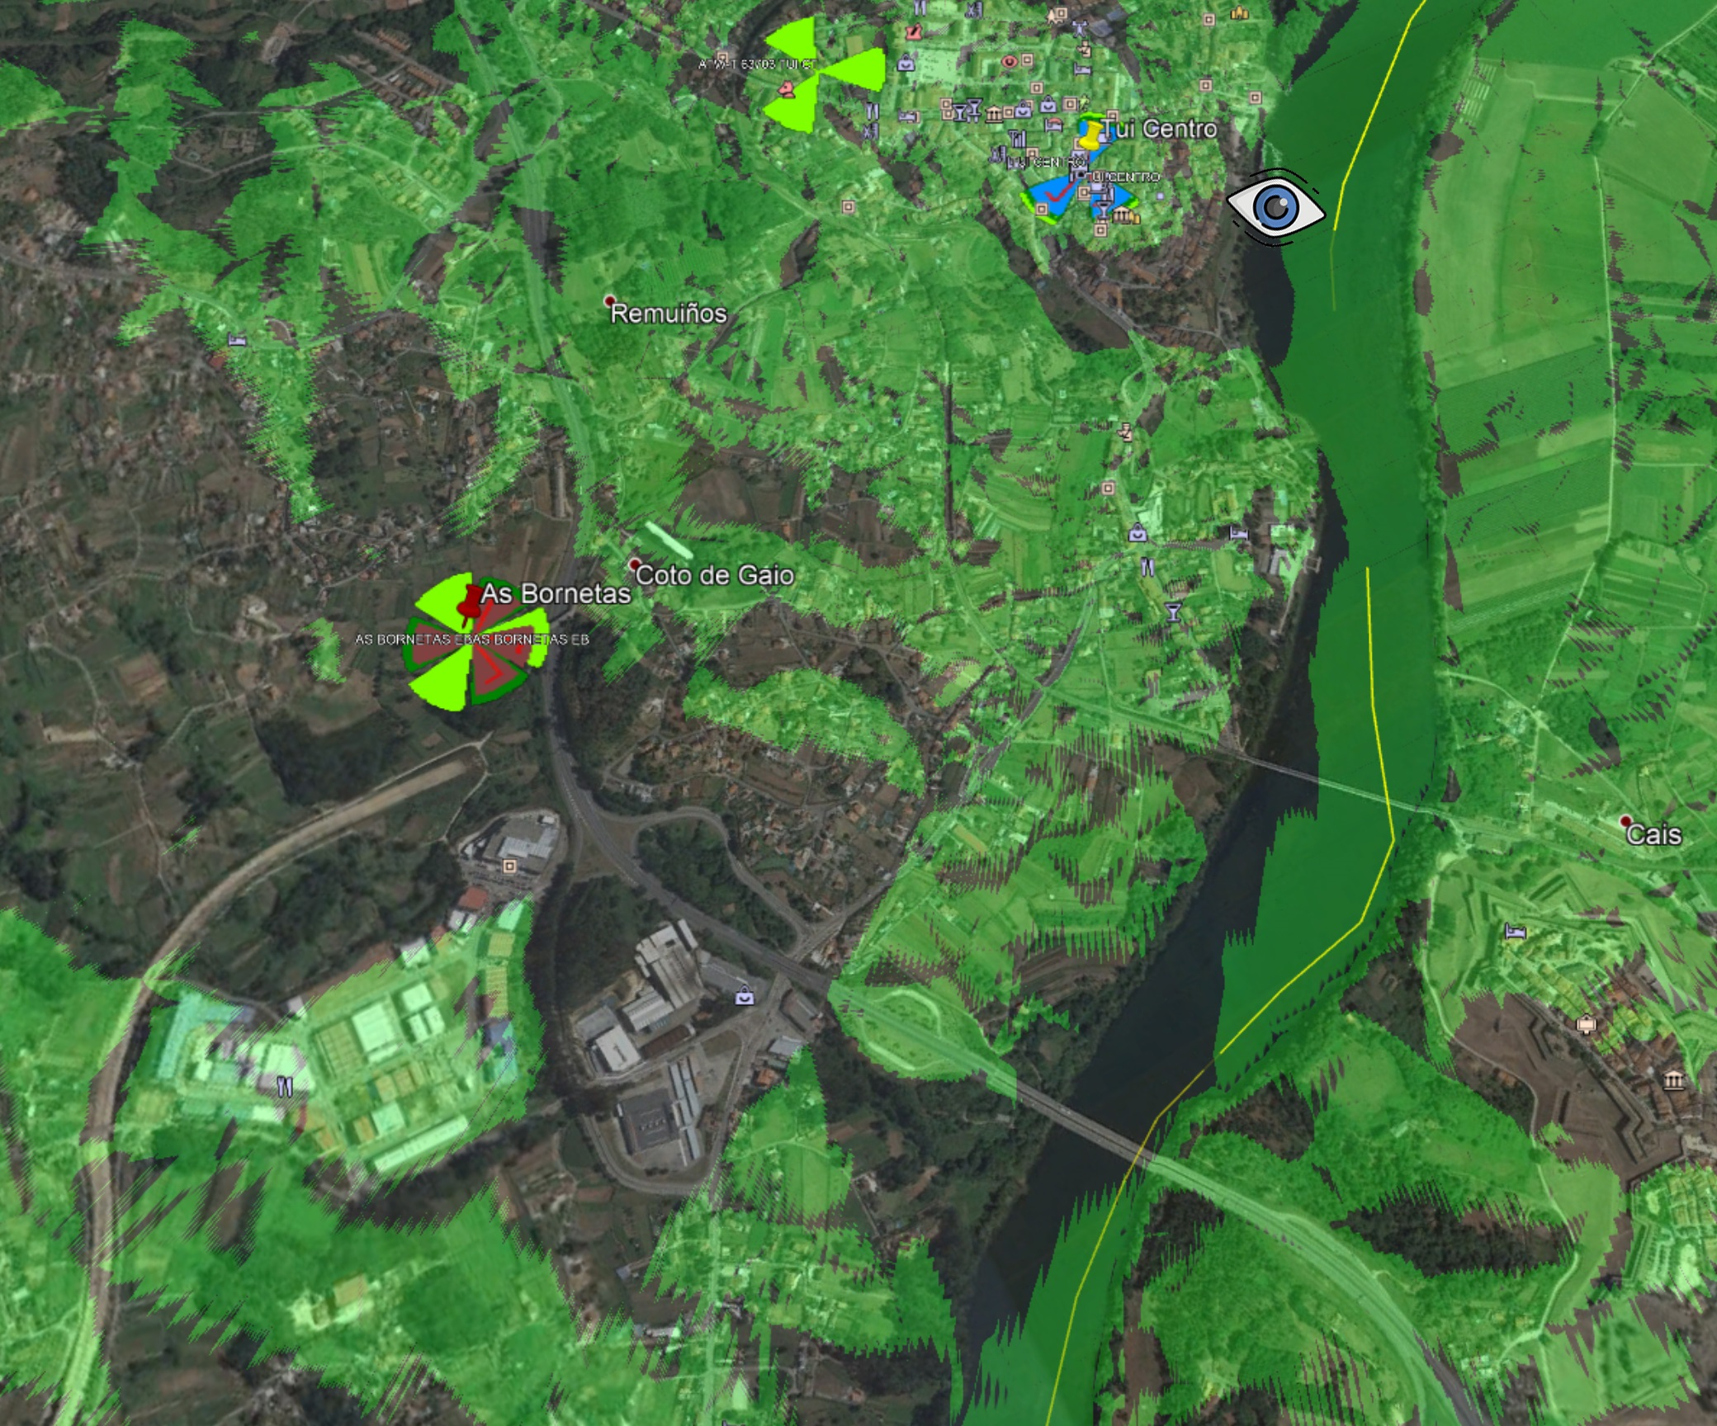
Preliminary results - Map
Line of sight from 5G Spanish sites
1400m
1400m
Line of sight from the 5G antennas to the bridges in the border in GREEN
As Bornetas
Tui-Centro

Slide 13
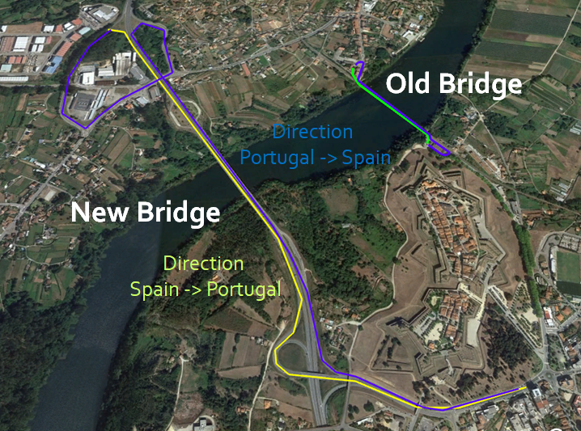
Preliminary results - Routes

Slide 14
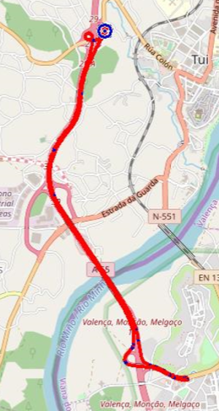
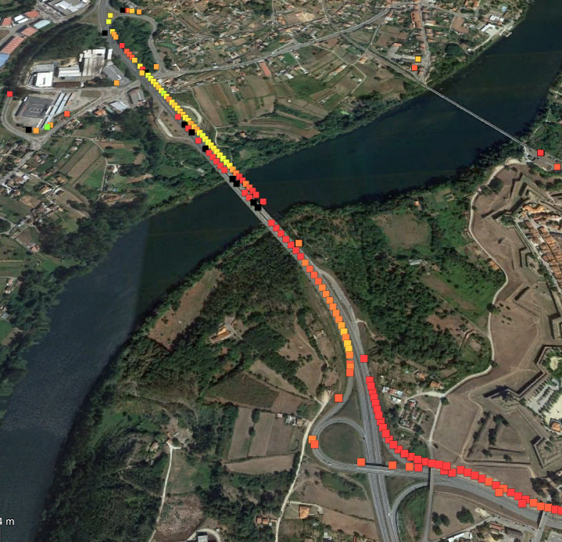
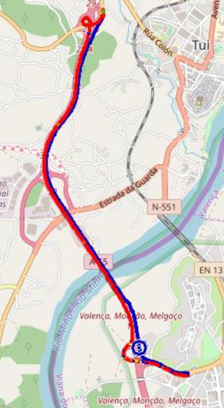
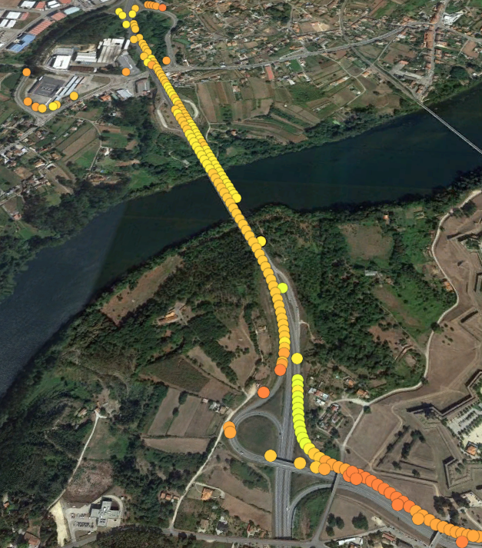
Preliminary results – Agnostic Scenarios New Bridge
DL Throughput
UL Throughput
RSRP

Slide 15
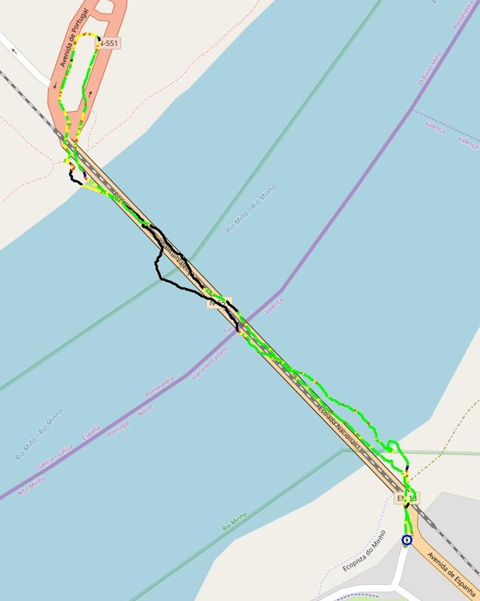
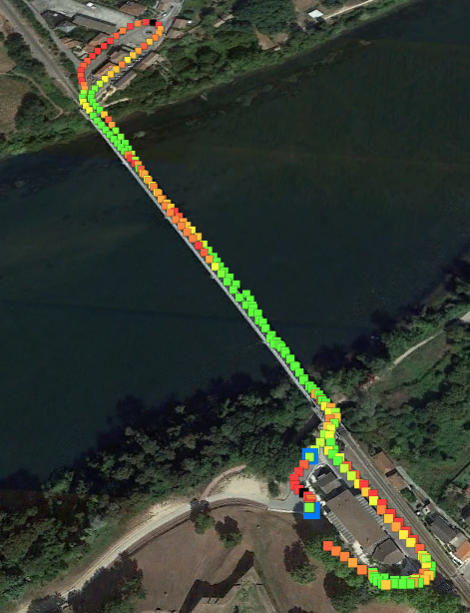
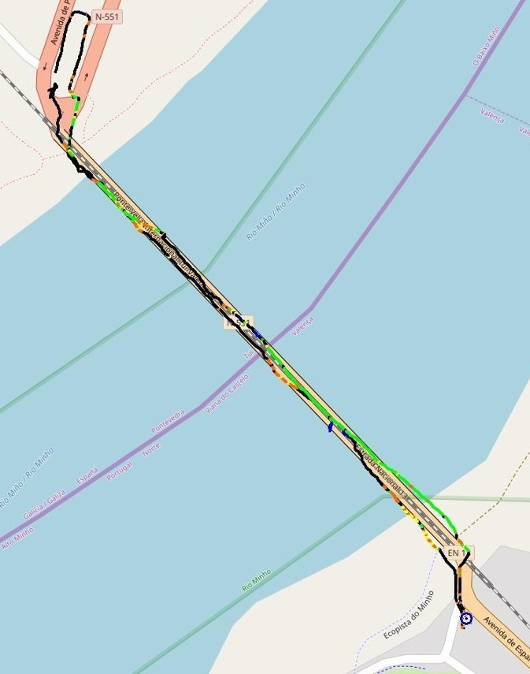
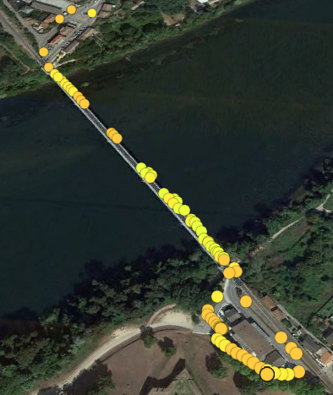
Preliminary results – Agnostic Scenarios Old Bridge
DL Throughput
UL Throughput
NR SS-RSRP

Slide 16
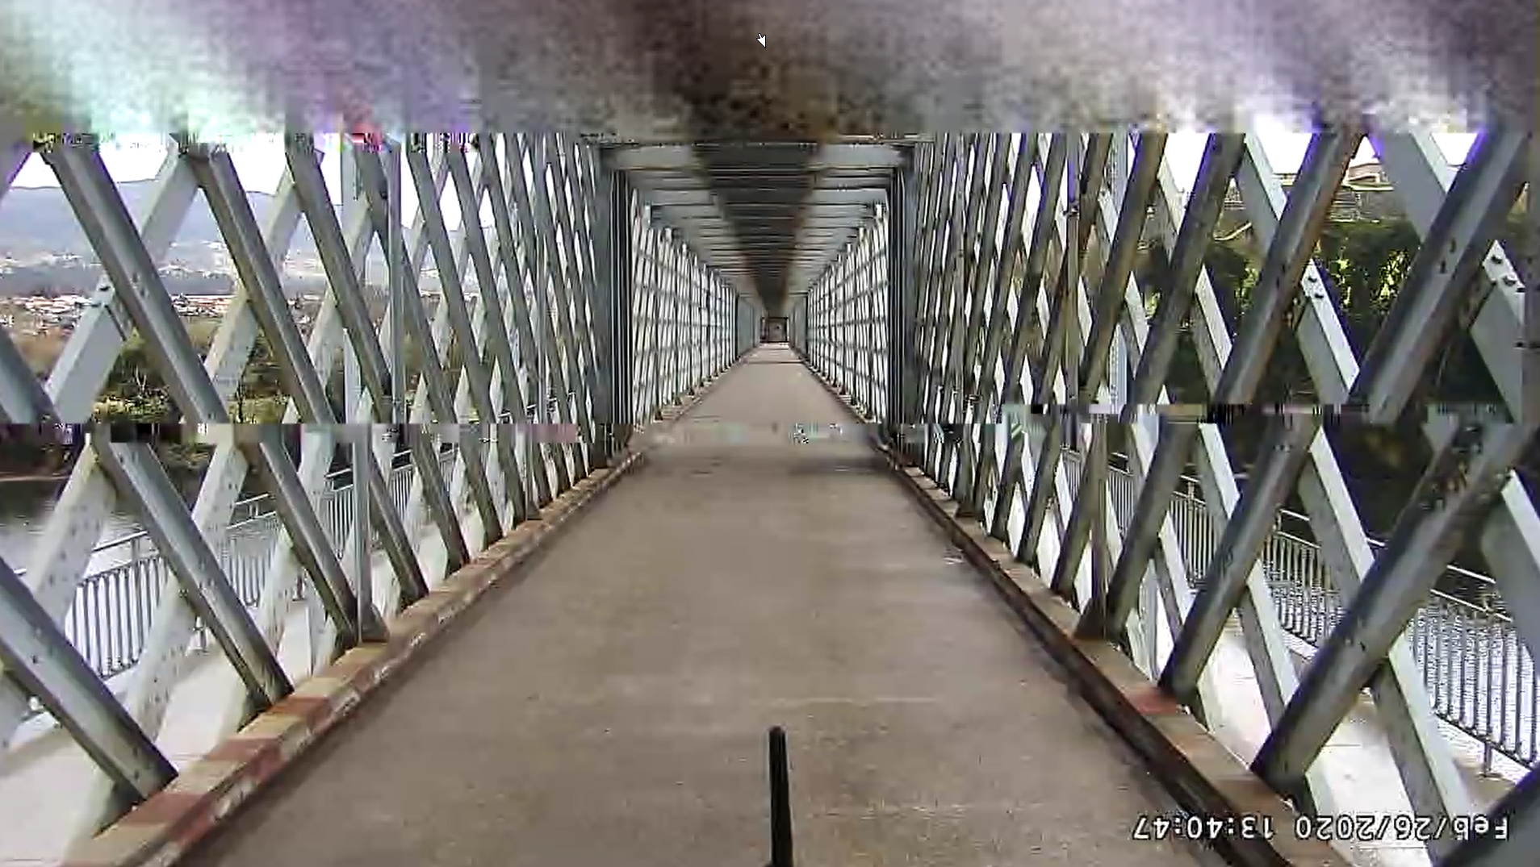
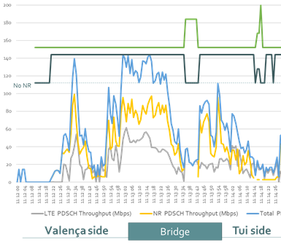
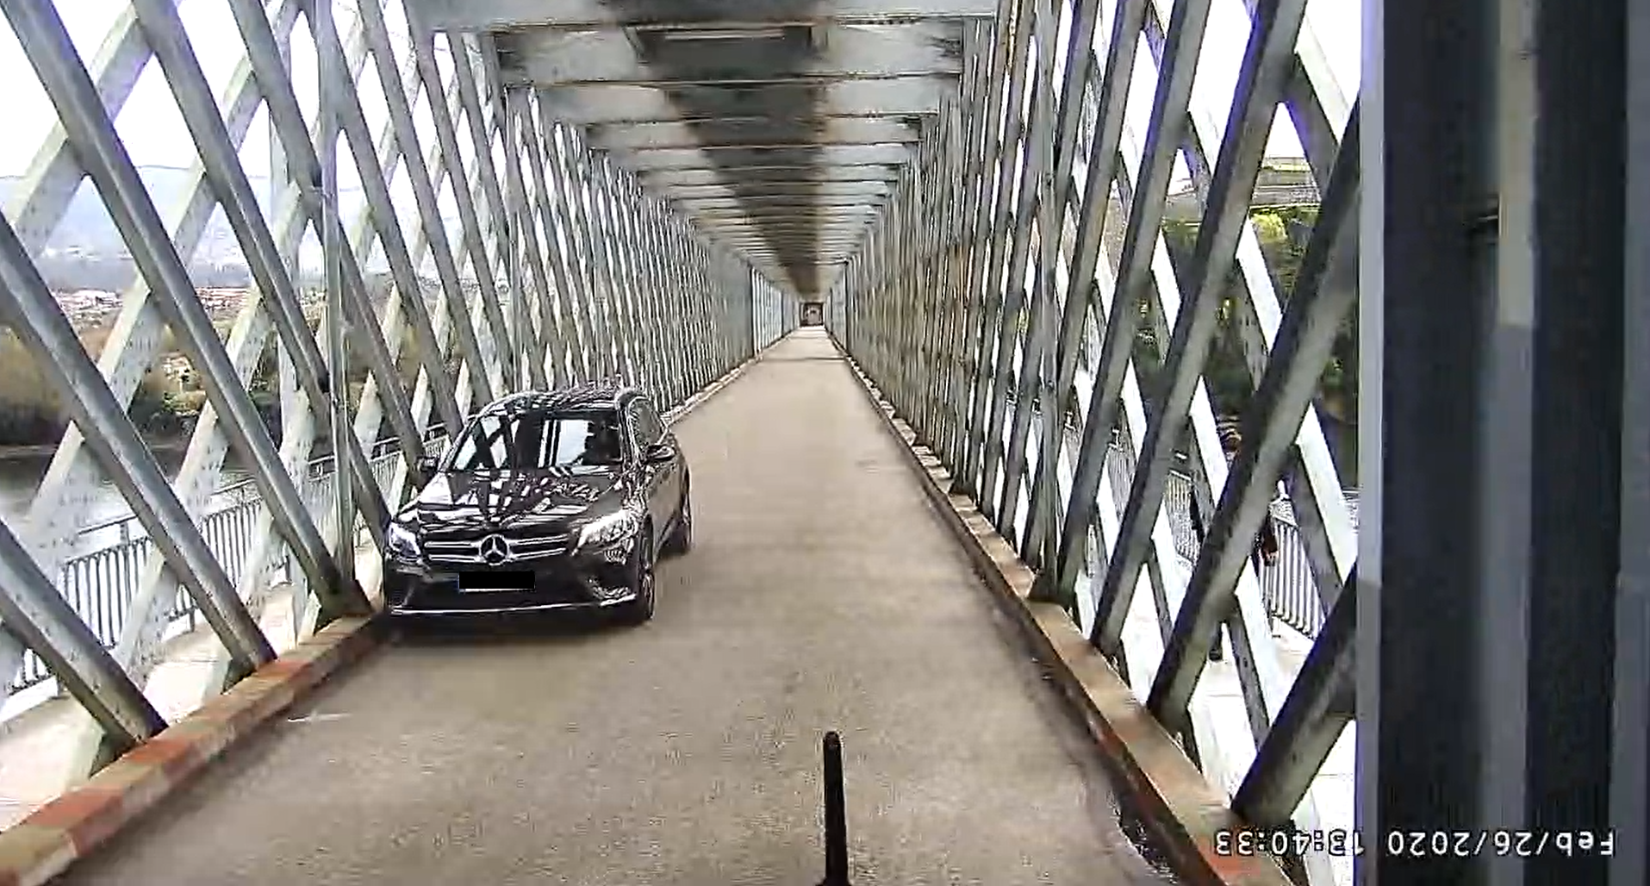
Preliminary results – Specific Scenarios Remote Driving US (Old Bridge)
US measurements: Camera streaming

Slide 17
Preliminary results in PT side

Slide 18
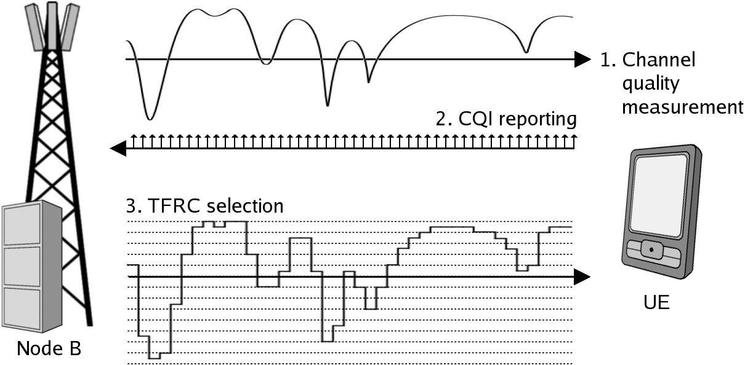
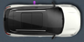
CBC 5G Network Assessment Framework
ITS
Centre
Cloud
Infra
Management System
QoS FSU
ITS
Centre
5G Network Core (MNO PT)
QoS FSU
5G Network (MNO ES)
3G/4G PLMN
QoS OBU
QoS OBU
QoS OBU
5G Access Network & MEC (MNO PT)
5G Access Network & MEC (MNO ES)
QoS FSU
QoS FSU
Test Traffic Streams
Control

Slide 19
Alternative 5G Network Assessment Strategy
Traffic Generation:
CCAM synthetic traffic, used to compute KPIs;
Background traffic, used to stress the network and compute KPIs;
Enables statistical relevance in results.
5G Performance Measurement Levels:
Radio, using QoS OBU with 5G modems;
MEC (accessing network performance indicators, on both MNOs);
ITS Centre (present in both countries).

Slide 20
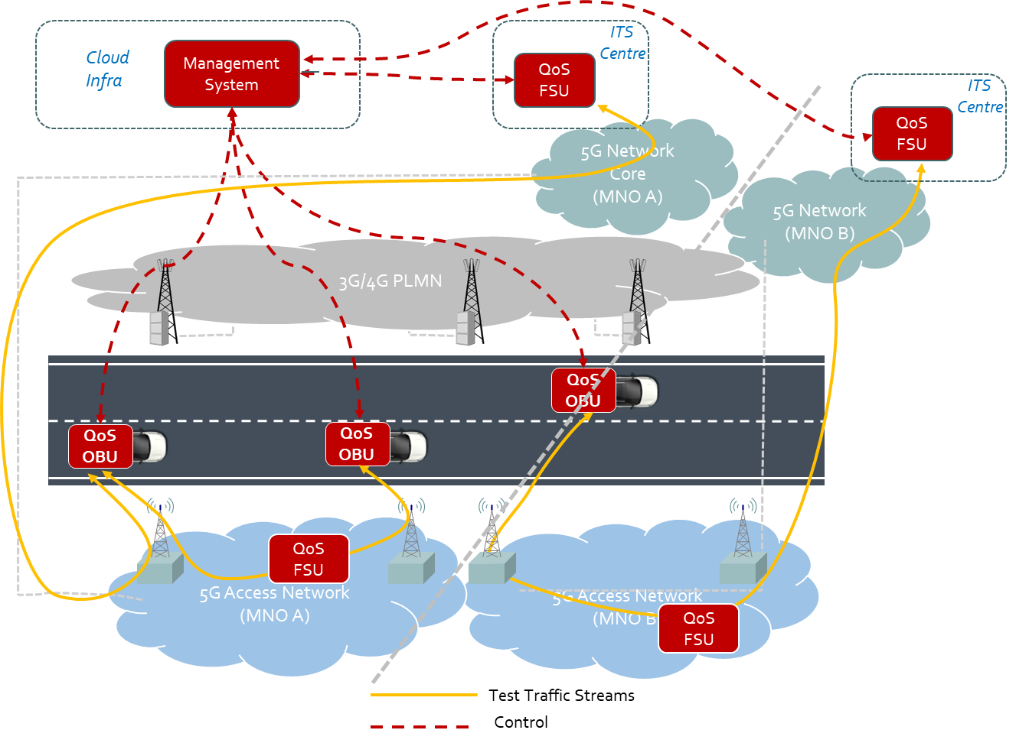
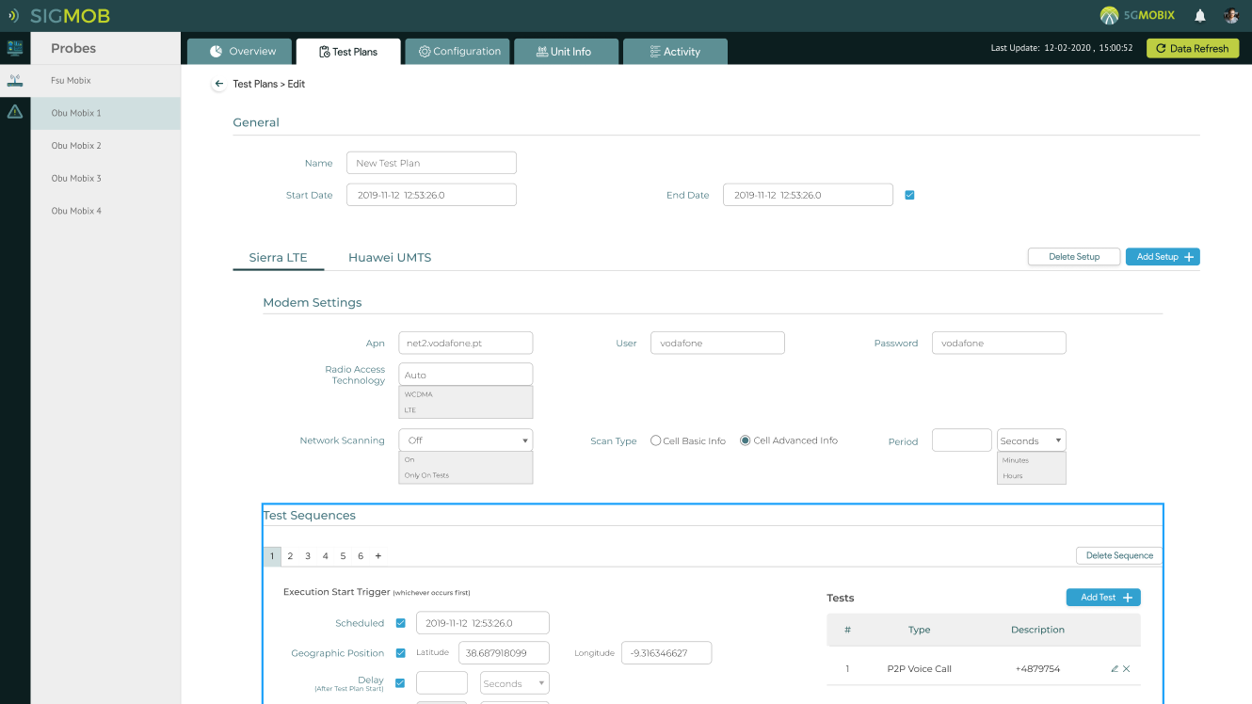
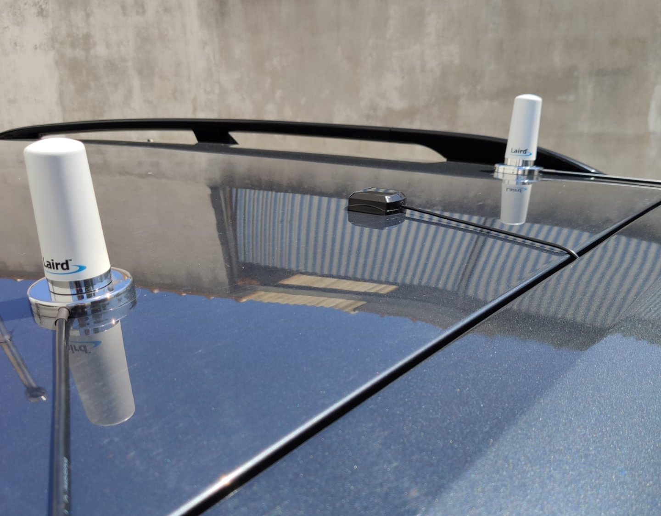
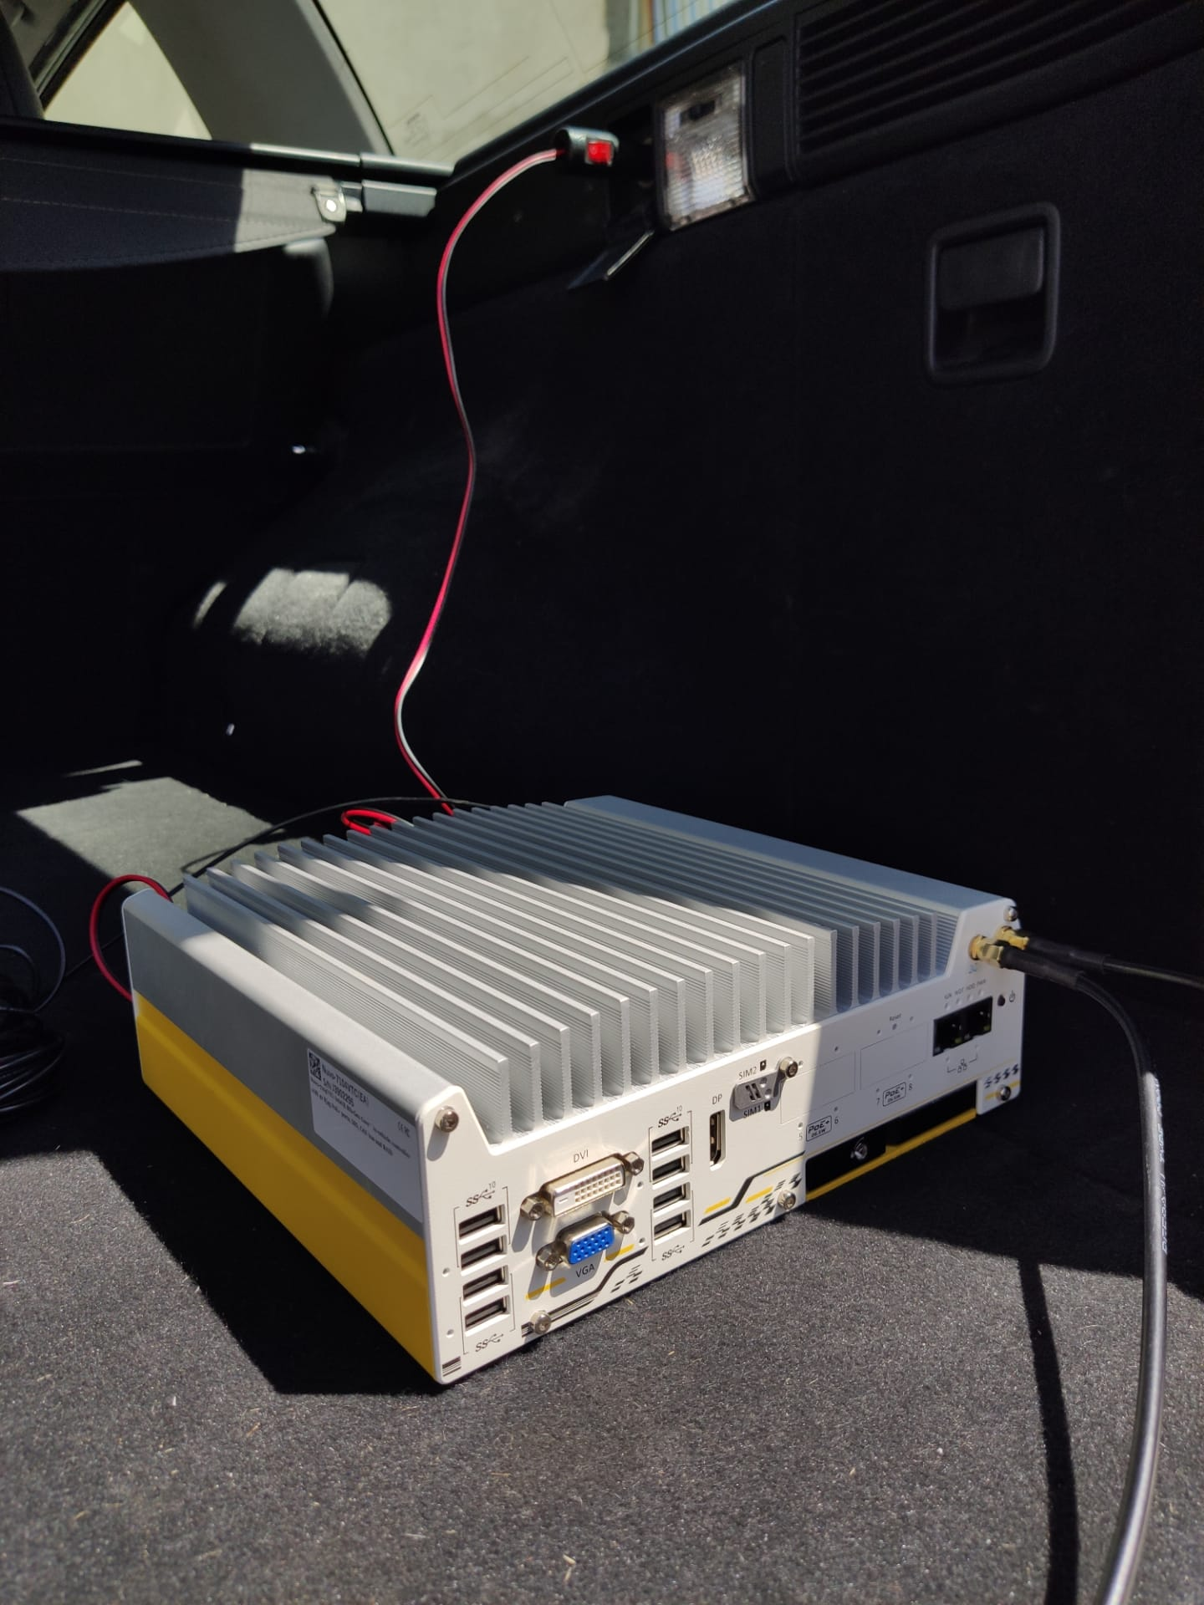
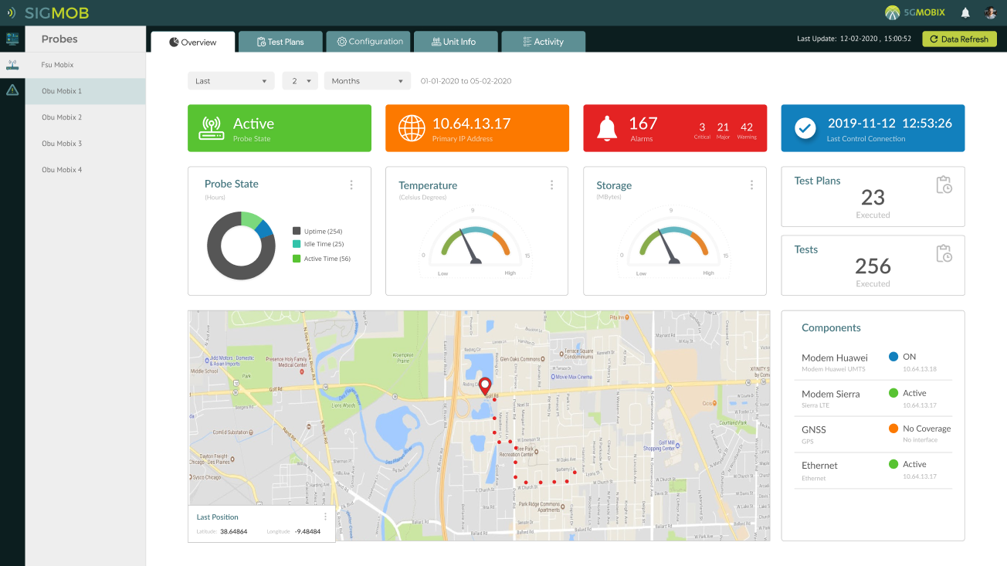
Dashboard and QoS OBU

Slide 21
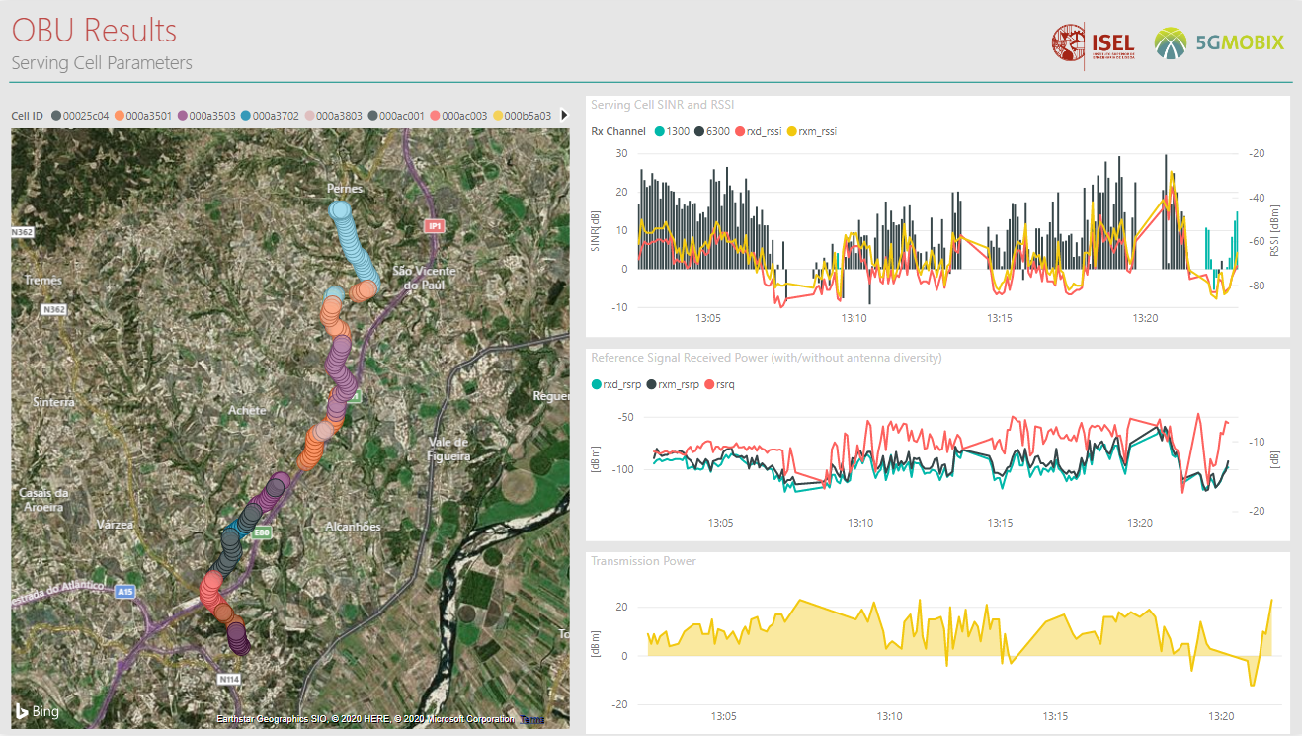
Radio Network Tests Results

Slide 22
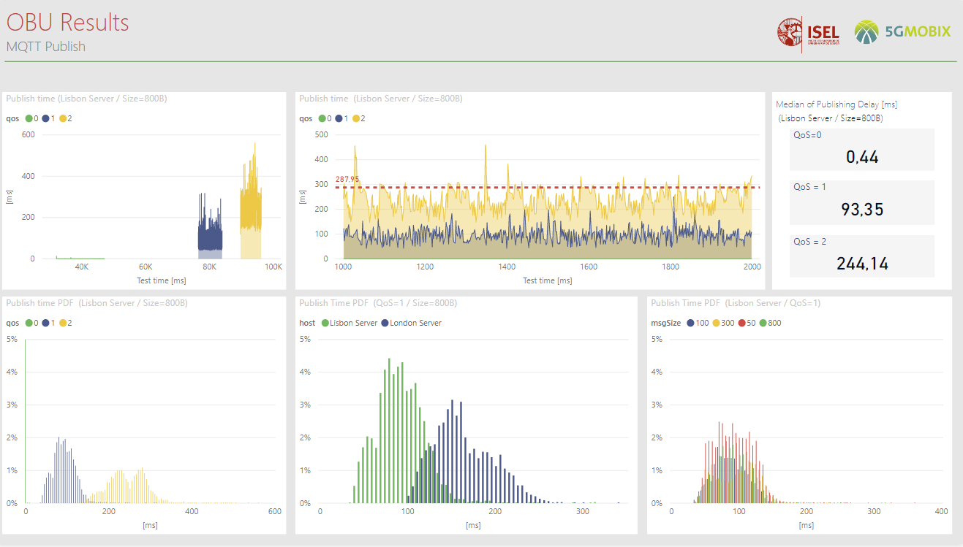
CCAM Preliminary Tests Results

Slide 23
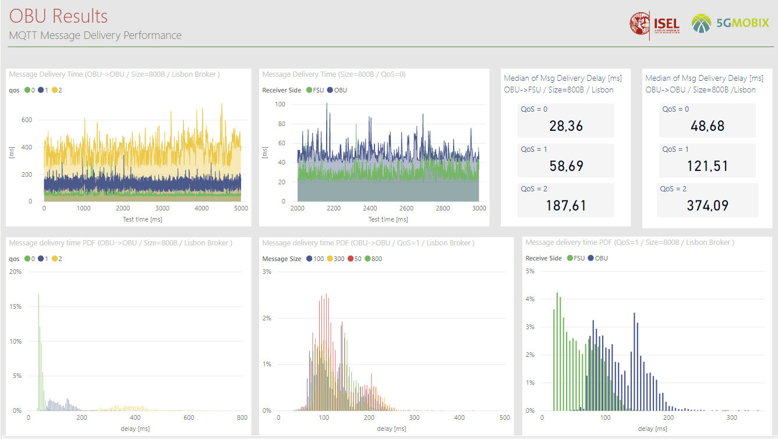
CCAM Preliminary Tests Results

Slide 24


