Slide 1

5G-MOBIX third Webinar

Slide 2
Welcome!

Slide 3
About the Webinar
The webinar is organised to present the main objectives and activities of the Greek-Turkish Cross-Border Corridor of 5G-MOBIX.
It will provide an overview of the corridor along with the challenges addressed; it will also be the occasion to exchange information regarding the 5G network infrastructure and features, the automated control of the vehicles as well as the rest of the developments and deployments that will enable the GR-TR trials.
5G-MOBIX 3rd Webinar, 29th June 2020

Slide 4
About the Webinar
The user stories designed for “Platooning with see-what-I-see functionality” and “Assisted Border Crossing” will be explained, summarizing the work made so far by the consortium in the Greek-Turkish Cross-Border Corridor but also presenting next steps.
An interactive session and a dedicated slot of 20 minutes for Q&A will follow the presentations.
5G-MOBIX 3rd Webinar, 29th June 2020

Slide 5
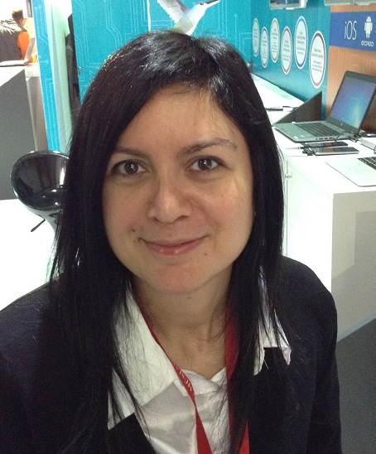
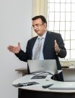
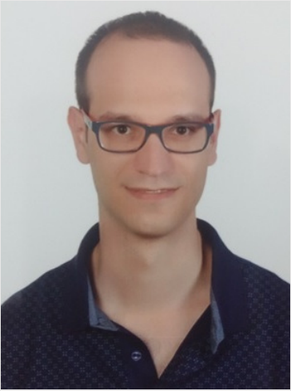
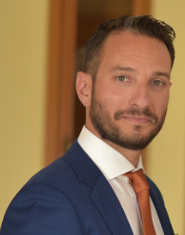


Speakers
Nazli
Guney
(TURKCELL)
Ioannis
Masmanidis
(ERICSSON GR)
Tahir
Sari
(FORD)
Kostas
Trichias
(WINGS ICT Solutions)
Barbara
Basdeki
(ICCS)
Moderator
5G-MOBIX 3rd Webinar, 29th June 2020

Slide 6
Agenda
Time | Presentation Title & Speaker
13.00 | Welcoming Barbara Basdeki, ICCS
13.00 – 13.15 | GR-TR CBC Overview Location information Partners and roles Roadmap Challenges and cross-border issues addressed @GR-TR Overview of next presentations Nazli Guney, TURKCELL
13.15 – 13.30 | 5G-Network Architecture 5G features Interconnection Current state of deployment Ioannis Masmanidis, ERICSSON GR
13.30 – 13.45 | Vehicle development and Platooning UC Ford truck presentation Platooning with see what I see + video TS-CBC collaboration with FI Routing in customs site Tahir Sari, FORD
13.45 – 14.00 | OBU/RSU/APP development and Assisted Border crossing UC OBU/RSU development Assisted border crossing Information flow + Sequence diagram + video Kostas Trichias, WINGS ICT Solutions
14.00 – 14.20 | Questions & Answers

Slide 7
Thank you

