Slide 1

5G-MOBIX Second Webinar

Slide 2
Welcome!

Slide 3
About the Webinar
The webinar is organised to present the Spanish-Portuguese Cross Border Corridor of the 5G-MOBIX project and its preliminary findings.
Particularly, it will give an overview of the corridor and the related use cases; the discussion will also include the 5G network infrastructure, as well as the Vehicle and Roadside one.
5G-MOBIX 2nd Webinar, 20th May 2020

Slide 4
About the Webinar
The participants will be informed regarding the Technical Evaluation, User Acceptance and Impact Assessment aspects.
Conclusions and outcomes from the Spanish-Portuguese Cross Border Corridor will give a comprehensive summary of the work made so far by the consortium and its most relevant outcomes.
5G-MOBIX 2nd Webinar, 20th May 2020

Slide 5

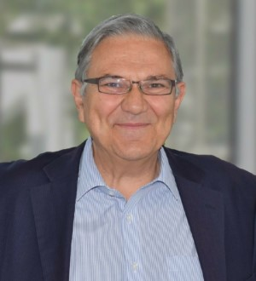


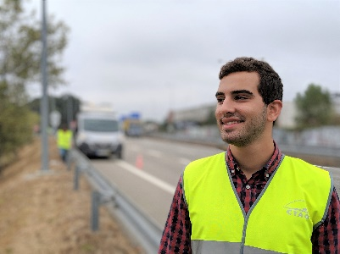
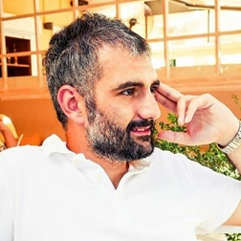
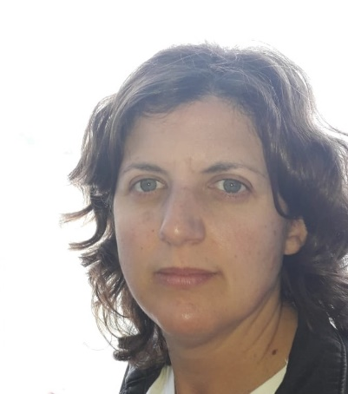
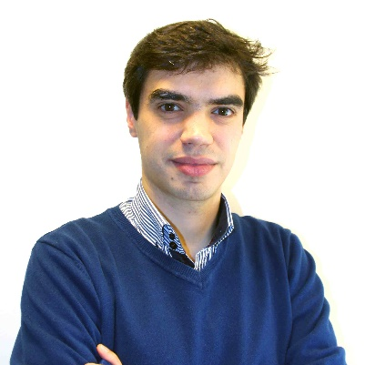
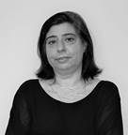
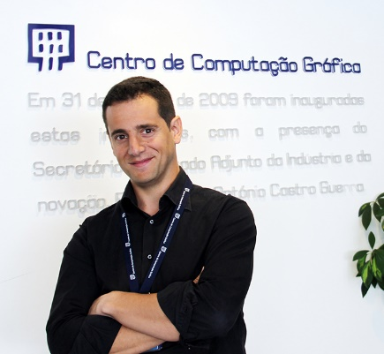

Speakers
Dr. Jorge Pereira
(European Commission DG CONNECT)
Nikolaos
Tsampieris
(ERTICO-ITS Europe)
Diana Blanco (CTAG)
Juan Francisco
(TELEFONICA)
Daniel Jáuregui
(CTAG)
Pantelis Kanellopoulos
(ICCS)
Marta Miranda
(CTAG)
Emanuel Sousa
(CCG)
Daniela Carvalho
(TIS)
João Moutinho
(CCG)
Moderator
5G-MOBIX 2nd Webinar, 20th May 2020

Slide 6
Agenda
Time | Presentation Title & Speaker
15.00 | Welcoming Pantelis Kanellopoulos, ICCS
15.00 – 15.10 | 5G-MOBIX Project Officer presentation Dr. Jorge Pereira, Principal Scientific Officer European Commission DG CONNECT Future Networks Future Connectivity Systems
15.10 – 15.20 | 5G-MOBIX Project presentation Nikolaos Tsampieris, ERTICO-ITS Europe
15.20 – 15.30 | Overview & Use Cases Diana Blanco, CTAG
15.30 – 15.40 | 5G Network Infrastructure Juan Francisco, TELEFONICA
15.40 – 15.50 | Vehicles and Roadside Infrastructure Daniel Jáuregui, CTAG
15.50 – 16.10 | Technical Evaluation Marta Miranda, CTAG
16.10 –16.20 | User Acceptance Evaluation Emanuel Sousa, CCG
16.20 –16.25 | Impact Assessment Daniela Carvalho, TIS
16.25 – 16.35 | Conclusions and Outcomes from ES-PT CBC Joao Moutinho, CCG
16.35 – 16.45 | Questions & Answers
5G-MOBIX 2nd Webinar, 20th May 2020

Slide 7
Thank you

