Slide 1
5G-MOBIX
GR-TR CBC Webinar
Vehicle development and Platooning UC
Tahir Sari (Platooning with See-What-I-See – FORD OTOSAN)
GR-TR Webinar, June 29th, 2020

Slide 2
Layout
Ford Truck Information
Platooning with See-What-I-See Application
  UC Overview, Diagrams
  TS-CBC collaboration with FI
  Early implementation video
Truck Routing in Customs Site
  UC Overview, Diagrams
Current GAPs from OEM Perspective
Project Overview & Key Achievements – 5GPPP TB eWorkshop – slide 2

Slide 3
Ford Truck Information

Slide 4
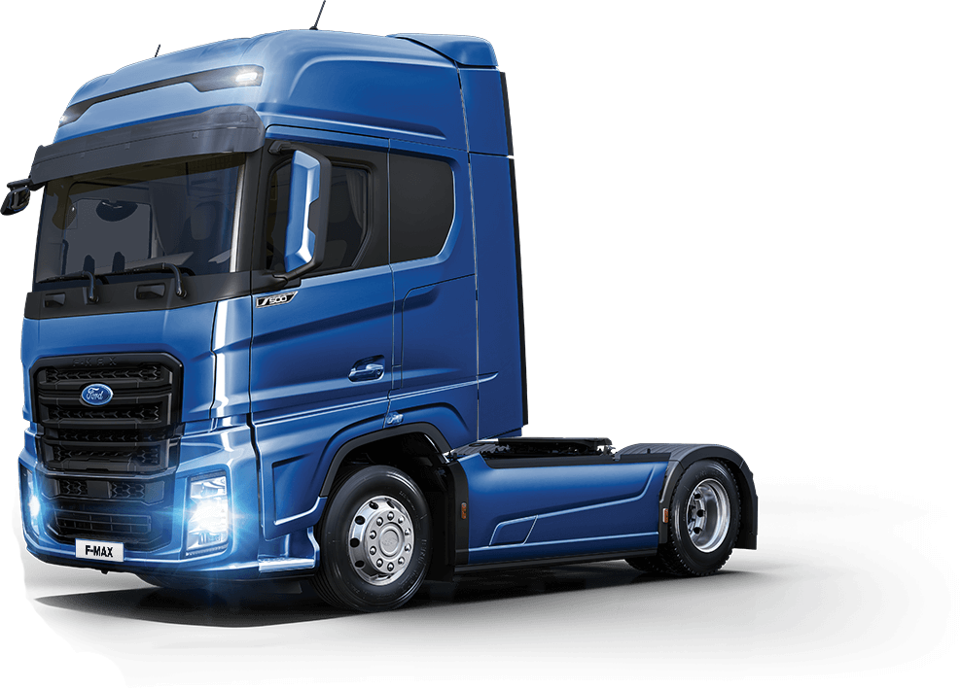

High Level Vehicle Architecture
Control Block
Camera
Radar
Brake Module
Private CAN
Vehicle CAN
OBU
Ethernet
microAutoBox dSpace
Engine Control Module
Ethernet
Ethernet
International Truck of the Year 2019
4K Camera
«See-what-I-see»
USB
LEVIS Client
HMI
Steering Module
Prototype
Sensor
Control ECU
Notes:
OBU details will be explained by Kostas, at the next session.

Slide 5
A bit detail…
dSPACE MicroAutoBox
C-V2X
Vehicle speed, accelariton, platooning state&gap, GNSS information
Longitudinal Control
ECM
Acc.
Decisions
Decision Maker
Sensors
Lane, Object
Info
Platooning/Truck Routing State
What to do next
HMI
Lateral Control
Steering Control Unit
Iniate‚Create platoon,
join request,
join accept,
join reject
Steering Decisions
Notes:
OBU details will be explained by Kostas, at the next session.

Slide 6
Platooning with See-What-I-See Application
UC Overview & Scenarios

Slide 7
Platooning with See-What-I-See Application
In a platoon, vehicles are moving much closer together than what would be possible if driven by human drivers
The reduced distance = greater fuel efficiency & reduced use of road space
Vehicles share their location, heading and speed as well as their intentions mainly over C-V2X Uu interface
PC5 interface as redundancy
Follower truck with autonomous acceleration/braking capabilities
4K video streaming from the leading truck to follower truck
Increased driver awareness & reduced anxiety levels

Slide 8
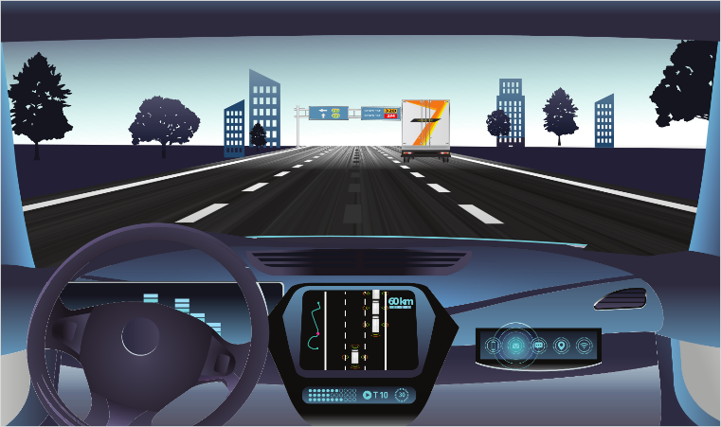
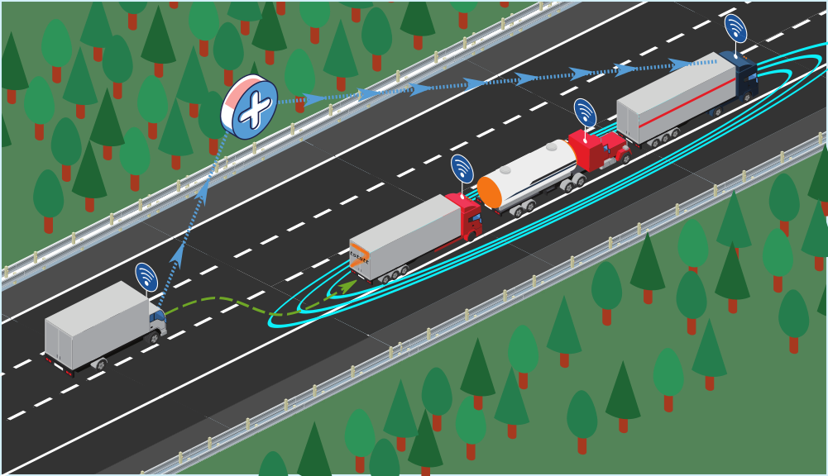

Platooning with See-What-I-See Application
In your truck, you have a touchscreen in which you can search for nearby platoons.
If one is found, then you can send a “join” request.

Slide 9
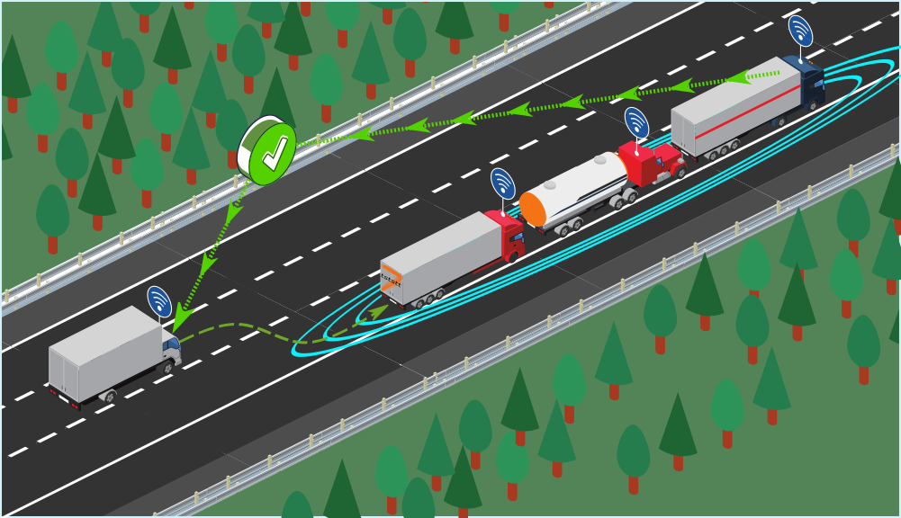

Platooning with See-What-I-See Application
The platoon leader will have to approve it. If he does, you can then approach the platoon
Location is displayed on the touchscreen and take the last place on the column.

Slide 10
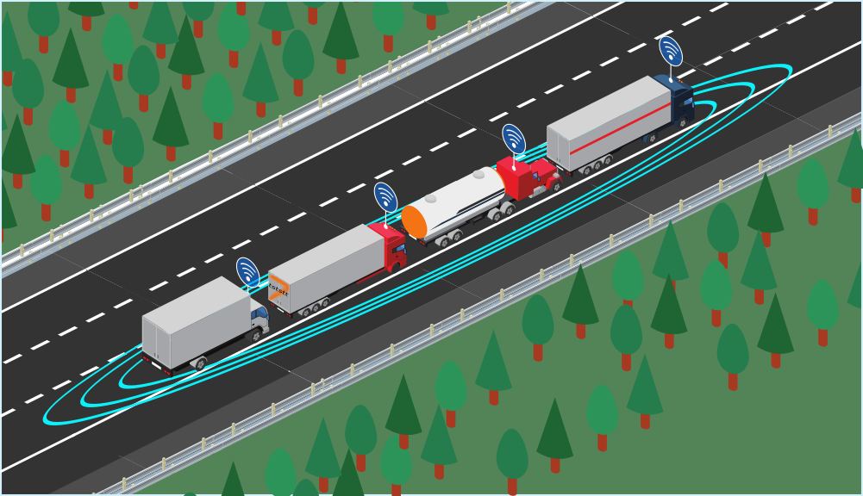
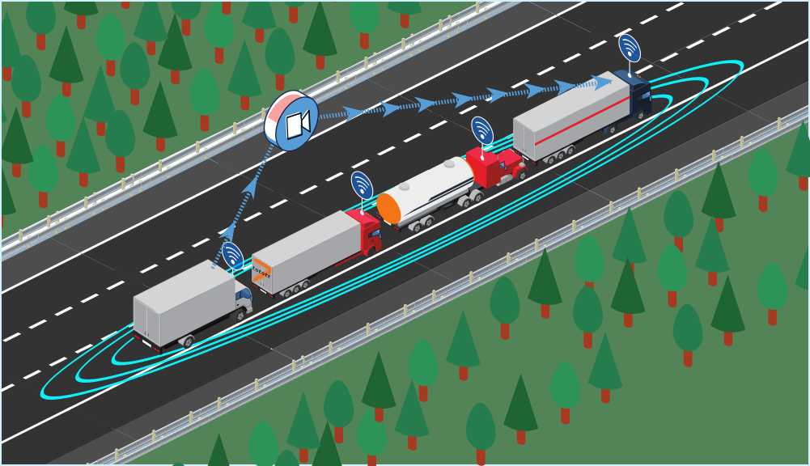
Platooning with See-What-I-See Application
At this point, the automatic system will take over and your vehicle will be automatically driven.
Once this integration is complete, you can request access from the leading driver to a "see what I see“ application.

Slide 11
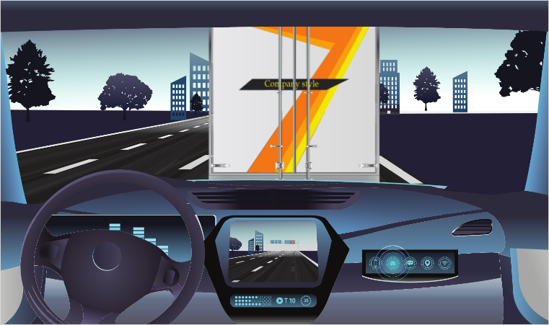
Platooning with See-What-I-See Application
Application allows you to see a continuous stream from a camera positioned on the leader’s windshield and pointed forward.
You can have a continuous vision of the road ahead of the leader and your cruise will be safer and more comfortable.

Slide 12

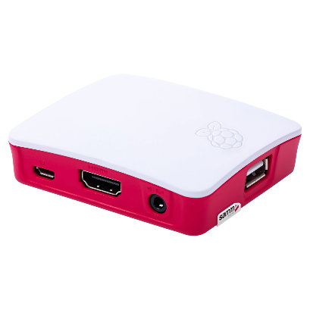
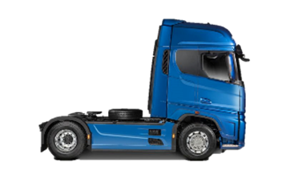

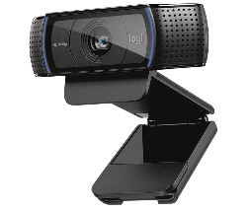
Streaming Application
LEVIS Streaming
Servers
LAN Network (Ethernet connection)
LAN Network (Ethernet connection)
5G C-V2N
5G C-V2N
OBU
OBU
Video
stream
LEVIS-Client
Jetson TX2
LEVIS-Client
Jetson TX2
Video
stream
HMI
4K
Camera

Slide 13

Vehicle Controller Early Implementations
https://www.youtube.com/watch?v=sirzW3AiPhU&t=31s

Slide 14
Truck Routing in Customs Site Application
UC Overview & Scenarios

Slide 15





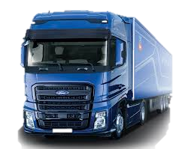
Truck Routing in Customs Site
  Decreased average border crossing time
  Prevention of accidents
  Sensor fusion technique for truck manoeuvres at the customs site
Truck routing
TÜBİTAK BİLGEM
Electronic file storage system
AI-based
X-ray data processing
Core Network
X-ray Building
Machine learning and deep learning
Integration into all customs gates
    5G Connected Truck Visit checkpoints autonomously
Store and make sense of X-ray scanning images of containers and trucks to cross the border
Plate
recognition
GREECE
CUSTOMS SITE
TURKEY
GREECE
TURKEY

Slide 16
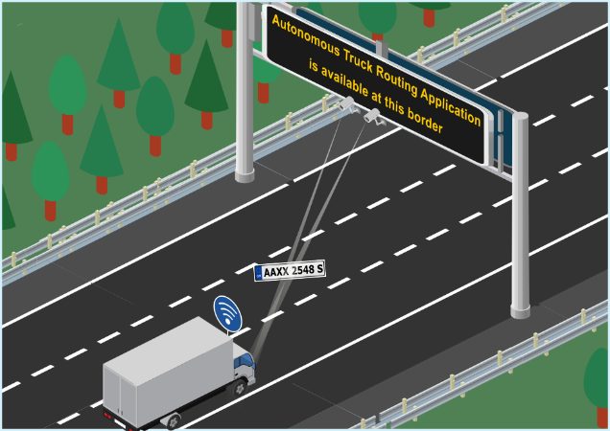
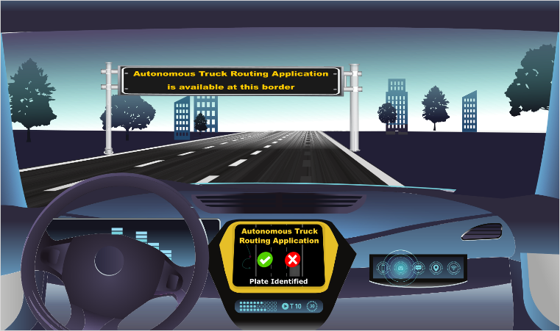
Scenario 2: Truck Routing in Customs Site
When you reach the border control facility you will see the message ‘Autonomous Truck Routing Application is available at this border’ written as road sign
After that point you can enable the ‘Autonomous Truck Routing Application’ via a tablet placed on your dashboard and the application will take over control of the truck.

Slide 17
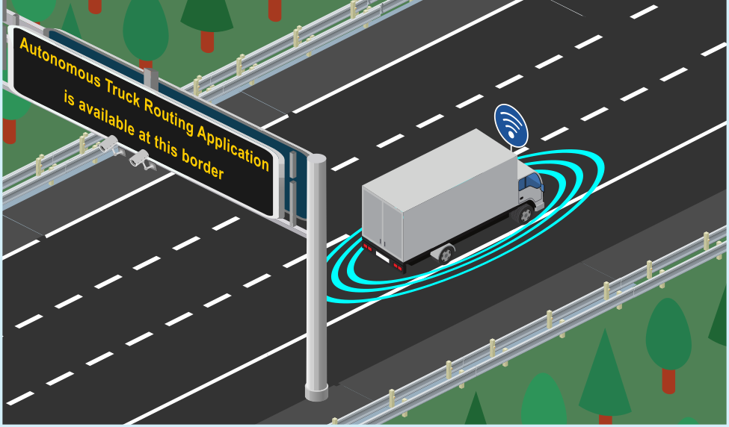
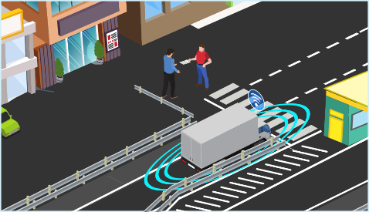
Scenario 2: Truck Routing in Customs Site
A plate recognition system will identify your truck at the entrance gate. Information will automatically be compared with relevant databases and a decision will be made regarding the need for x-ray inspection.
From this point on, the application will drive the vehicle and you will only have to intervene if something unexpected occurs.

Slide 18
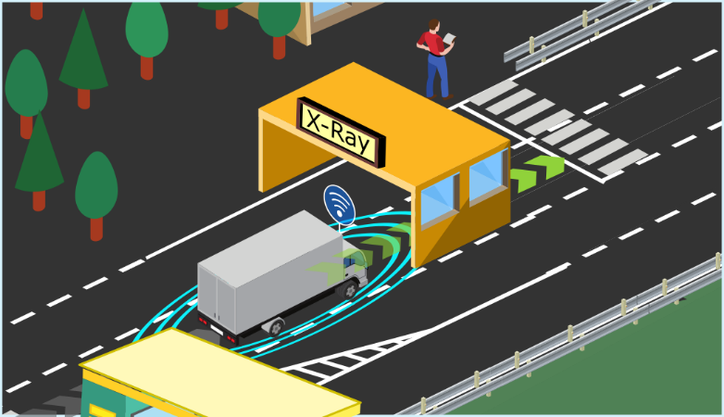
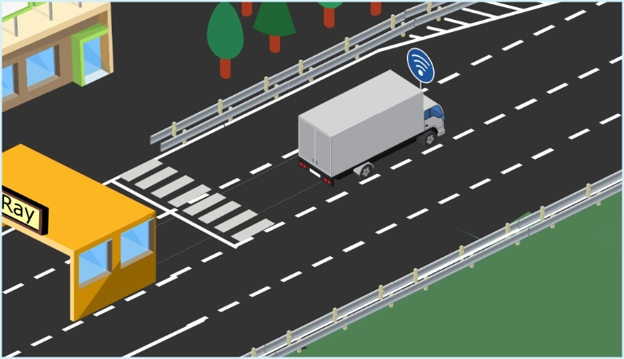
Scenario 2: Truck Routing in Customs Site
If an inspection is necessary, the truck will drive itself to defined inspection points, including x-ray, following instructions from a centralized control system that manages the operations of the border facility.
After the inspection, if everything is ok, you will be able to go back to the truck and follow your way.

Slide 19
Current 5G-CCAM GAPs from OEM Perspective

Slide 20
Current 5G-CCAM GAPs from OEM Perspective
When we will see common 5G deployment around EU highways?
How will be revenue stream for 5G-CCAM services?
How to act if autonomy regulations are different between neighbour countries?
How to act if GDPRs are different between neighbour countries?
Cybersecurity concerns…

Slide 21
Thank you
Questions?

Slide 22
Thank you
BACK-UP

Slide 23
Message Flow – Platooning
Leader Vehicle
Base Station
Cloud
Follower Vehicle
Actuators & HMI
MABX
OBU
Camera & Client
vEPC
SWIS App
Platooning App
Actuators & HMI
MABX
OBU
Create Platoon
Create Platoon
Create Platoon
Create Platoon
Platoon Created
Platoon ID Saved
Platoon Created
Search and Join Platoon
Platoon Created
Platoon Created
Search and Join Platoon
Join Platoon
Join Platoon
Join Request
Join Request
Join Request
Join Accepted
Join Accepted
Join Accepted
Confirmation Message
Follower Platoon ID Saved
Confirmation Message

Slide 24
Message Flow – See What I See
Follower Vehicle
Leader Vehicle
Cloud
Display
Jetson TX2
OBU
Camera
AGX Xavier
OBU
LEVIS-Server
Request a live stream
Forward the request to the server
Ok response
Ok response
Start RTSP server
Start video player and try to connect to the server
Forward the request
Request the live stream
Start live stream
Send raw stream
H264/H265 Encoding
Waiting for the stream to be available
Sending encoded frames over UDP
Sending encoded frames over UDP
Receive frames from port xxxx and stream over RTSP on port yyyy
Establish RTSP session once the stream is available
Push the stream over UDP
Forward the stream to the Jetson TX2
H264/H265 decoding
Send to display

