Slide 1
5G-MOBIX GR-TR CBC Webinar
OBU/RSU development and
Assisted Border crossing UC
Kostas Trichias (Technical Coordinator – WINGS ICT Solutions) GR-TR Webinar, June 29th, 2020

Slide 2
Layout
Overview information
OBU / RSU Development
IMEC OBU (Platooning UC)
WINGS OBU (Assisted Border Crossing UC)
IMEC RSU (Platooning UC)
Assisted “zero touch” truck border crossing UC
UC Overview, Diagram and info flow
Platform development & functionality
Early implementation video
GR-TR Webinar – June 29th 2020 – slide 2

Slide 3
OBU/RSU/APP overview information
HW & SW developed for the GR-TR CBC
2 OBUs (IMEC + WINGS)
3 RSUs (IMEC)
3 Applications (WINGS, ICCS, Tubitak)
IMEC developed OBU and RSUs will focus on the provisioning of the “Platooning with See-what-I-See” & “Autonomous truck routing in customs” Use cases
WINGS developed OBU will focus on the provisioning of the “Assisted – zero touch- truck border crossing” use cases
Application development
Platooning (FORD) + See-what-I-See (ICCS) → already presented
Truck routing in customs site (TUBITAK) → already presented
Assisted – zero touch- truck border crossing (WINGS)
GR-TR Webinar – June 29th 2020 – slide 3

Slide 4
OBU / RSU Development

Slide 5
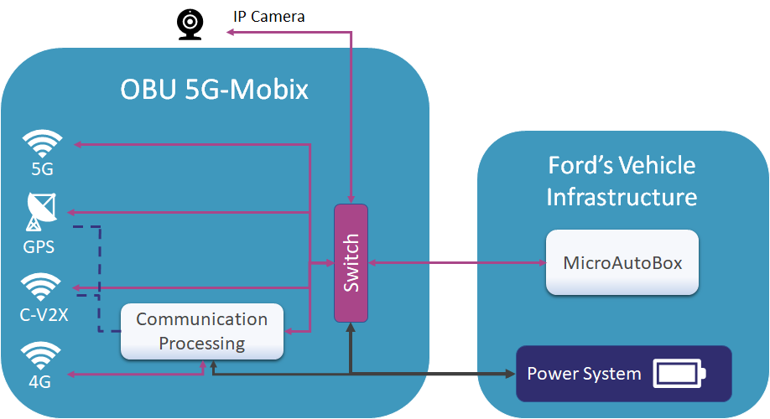
IMEC OBU Architecture
IMEC OBU
offers V2X wireless communications capabilities (5G Uu and C-V2X PC5)
has communication processing unit and can provide logging
4G is used for remote recovery
its switch can be connected to an external sensor/camera for streaming application
Ford’s vehicle infrastructure
MicroAutoBox acts as an ECU (connected to truck’s CAN) that will process sensor information
IMEC’s OBU is connected to Ford’s ECU (MicroAutoBox), acting as a gateway to forward information from and to the truck
GR-TR Webinar – June 29th 2020 – slide 5

Slide 6
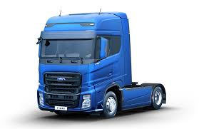
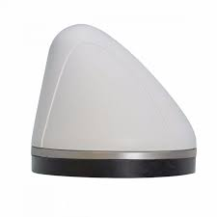
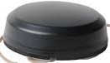
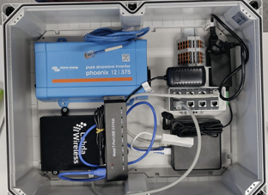
IMEC OBU Specifications
Hardware:
V2X processing unit: NUC7iDNKE
Ethernet Switch: Phoenix gigabit switch
C-V2X: Cohda MK6C
4G module: Mikrotik wAP LTE kit
Positioning System: Navilock NL-8012U GPS
5G Modem: Quectel RM500Q.
OBU will be put inside Ford’s trucks
Antennas will be on top of the truck
GR-TR Webinar – June 29th 2020 – slide 6

Slide 7
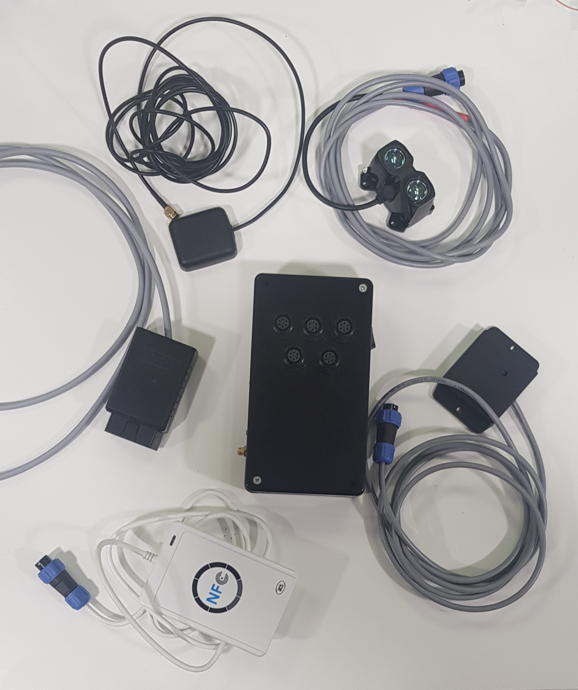
WINGS OBU development
Proximity Sensor
WINGS developing OBU for the Assisted border crossing use case including the multitude of sensors (GPS, CO2, Proximity, NFC)
To be integrated with the FORD truck and IMEC OBU
Main functions
Send driving instructions to FORD truck ECU
Assess “Risk level” of each incoming truck based on collected information. Indicate proper inspection level based on outcome
Protect customs agents based on Proximity and GPS readings
Status
Functionality ready
Upgrade with 5G chipsets ongoing (Quectel RM500Q)
GPS
ECU connector
OBU
CO2 Sensor
NFC reader
GR-TR Webinar – June 29th 2020 – slide 7

Slide 8
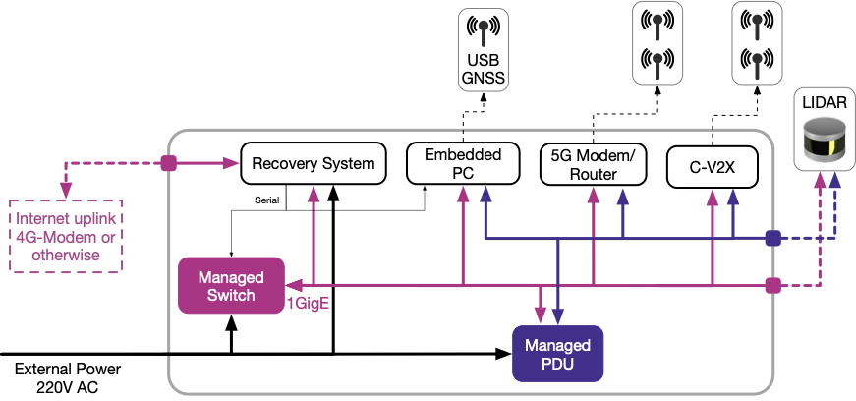
RSU Architecture
3 RSUs to be deployed at the Turkish border customs site
RSUs will be installed at the side of the road and will be able to provide a network uplink for the LIDAR
equipped with communications modules, including the 5G modem, and the C-V2X PC5 unit
GR-TR Webinar – June 29th 2020 – slide 8

Slide 9
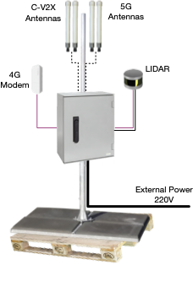
RSU Specifications
Hardware:
Embedded PC
5G Modem: Quectel RM500Q
C-V2X: Cohda MK6c
VLP-16 Lidar
Managed Switch
Managed PDU
PC Engines APU2 (Recovery System)
The C-V2X module and 5G-modem will be connected to external antennas using coax cable. This is done to optimise the coverage of these modules
LIDAR will be mounted to the mounting pole using a specialised mounting bracket
GR-TR Webinar – June 29th 2020 – slide 9

Slide 10
Assisted – zero touch- truck border crossing UC UC Overview & Scenarios

Slide 11
Assisted “zero-touch” Border Crossing
Utilize AI & predictive analytics techniques to perform threat classification of incoming vehicles at the customs sites
Ingest heterogeneous information from:
Vehicle On-Board Unit (OBU) and connected sensors
Road-Side Infrastructure (RSI) and connected sensors
Neighbouring authorities
Enable state-of-the-art services such as:
Detection of human or livestock smuggling attempts
Detection of cargo smuggling attempts (contraband)
Customs agents protection from (autonomous) vehicles
Provide seamless “zero-touch” access (no inspection) through the borders to legitimate vehicles
GR-TR Webinar – June 29th 2020 – slide 11

Slide 12
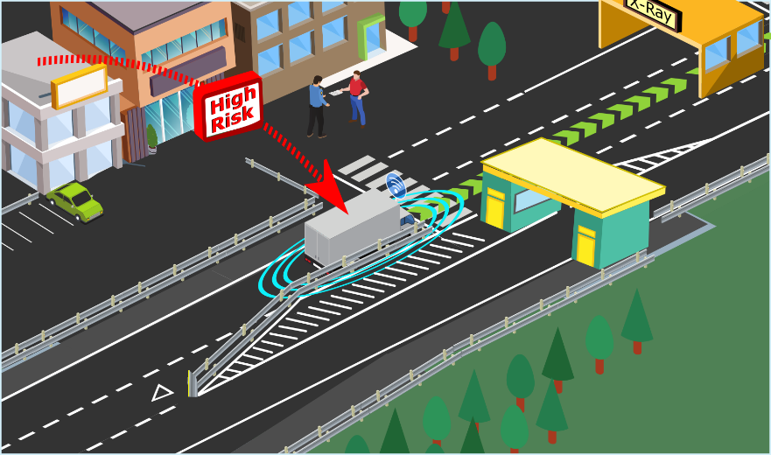
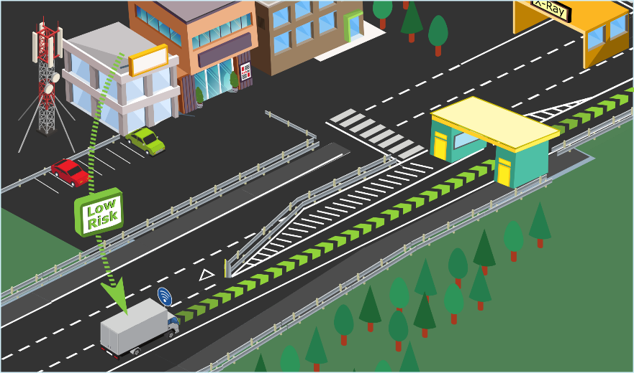

Scenario 1: Human/livestock smuggling detection
Perform Risk / Threat assessment based on input from CO2 sensor and truck manifest
In case human / livestock presence is detected (in vehicle or cargo haul) issue a “High Risk” alert and instruct further inspection (resulting in autonomous driving instructions)
In case NO human / livestock presence is detected , issue a “Low Risk” notification and instruct a –zero touch- border crossing (resulting in autonomous driving instructions)
GR-TR Webinar – June 29th 2020 – slide 12

Slide 13
Scenario 2: Cargo smuggling detection
All cargo in a vehicle (or cargo haul) is identified based on a wireless technology (e.g. NFC)
Identified cargo inventory cross-checked with the vehicle’s documentation / manifest (potentially received from neighboring country)
In case unauthorized cargo is detected issue a “High Risk” alert and instruct further inspection (resulting in autonomous driving instructions)
In case NO unauthorized cargo is detected , issue a “Low Risk” notification and instruct a –zero touch- border crossing (resulting in autonomous driving instructions)
GR-TR Webinar – June 29th 2020 – slide 13

Slide 14
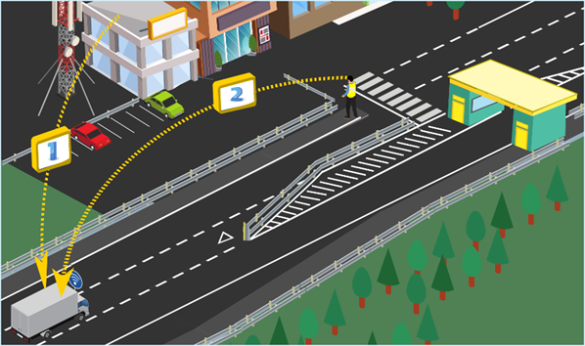
Scenario 3: Customs agents protection
Customs agents location monitored via Proximity & GPS readings
Once the vehicle’s trajectory is determined to potentially lead to a collision or an accident with customs agents an alert is issued.
Autonomous vehicles are instructed to stop or change course
GR-TR Webinar – June 29th 2020 – slide 14

Slide 15
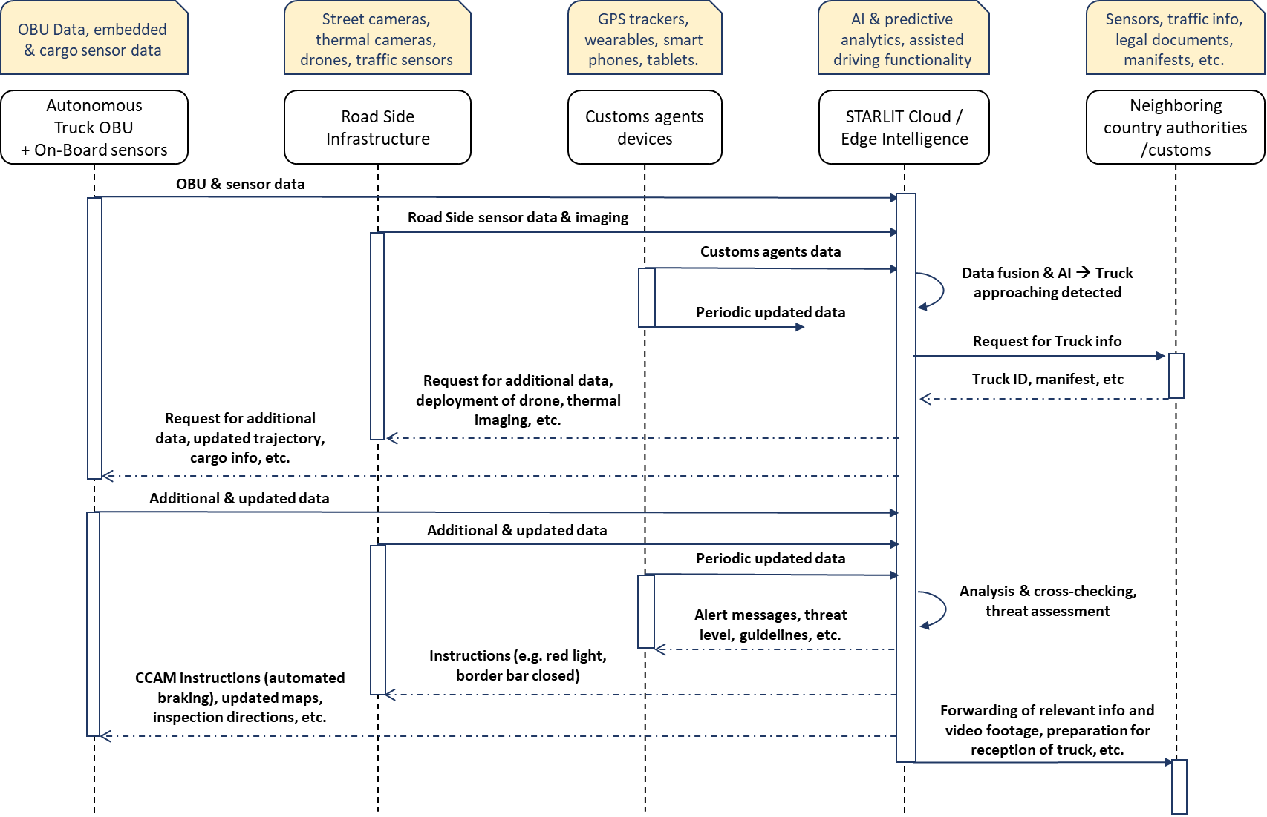
UC Flow Diagram

Slide 16
Assisted – zero touch- truck border crossing UC UC Architecture & Information flow

Slide 17





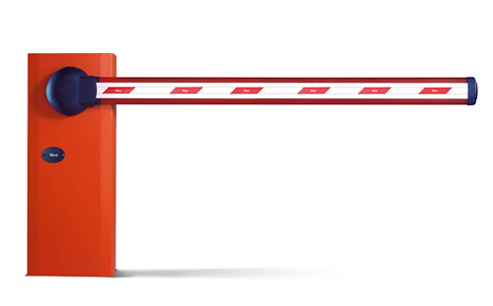








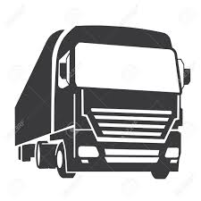

TR side - Turkcell
GR side - Cosmote
WINGS Cloud Platform (STARLIT) WINGS facilities in Athens
MEC
Customs site – Road side infra
Core functions (SGW / PGW)
Direct Interconnection
Core functions (SGW / PGW)
gNB
gNB
License plate recognition
On-Board Sensors (OBU)
Overall Architecture including ALL components
Proximity
GR-TR Webinar – June 29th 2020 – slide 17

Slide 18
TR side - Turkcell
GR side - Cosmote
WINGS Cloud Platform (STARLIT) WINGS facilities in Athens
MEC
Customs site – Road side infra
Core functions (SGW / PGW)
Direct Interconnection
Core functions (SGW / PGW)
gNB
gNB
License plate recognition
Tx Info: Camera picture, light status, GPS coord
On-Board Sensors (OBU)
Rx Info: Instruction messages for border bar and traffic light, GUI info.
Proximity
Tx Info: Truck manifest (doc)
Tx Info: CO2, NFC, Lidar distance, GPS coord., ECU info
Rx Info: GUI info (incl. figs)
Rx Info: Instruction messages, GUI info.
GR-TR Webinar – June 29th 2020 – slide 18

Slide 19
TR side - Turkcell
Scenario A – Public IP
GR side - Cosmote
RX#3
RX#6
WINGS Cloud Platform (STARLIT) WINGS facilities in Athens
RX#2
RX#5
RX#1
RX#4
Customs site – Road side infra
Core functions (SGW / PGW)
Direct Interconnection
Core functions (SGW / PGW)
TX#1
gNB
gNB
TX#5
License plate recognition
TX#3
On-Board Sensors (OBU)
TX#4
TX#2
Proximity
GR-TR Webinar – June 29th 2020 – slide 19

Slide 20
Assisted – zero touch- truck border crossing UC Cloud/Edge Platform & GUI

Slide 21
WINGS Cloud/Edge platform & GUIs
Cloud Intelligence: Data ingestion and analytics SW provided by WINGS (based on STARLIT platform) resides both in a centralized cloud as well as at the edge nodes to facilitate low-latency communication. Two GUIs are provided with live feed from the Cloud platform with relevant information and sensor readings i) for the customs agents and ii) for the truck driver
Algorithm input: GPS coordinates, CO2 readings, license plate recognized, thermal reading of the truck, NFC cargo ID, proximity to obstacle / human, truck cargo manifest
Algorithm output: Truck threat assessment and classification. Utilized to make a decision to allow the border crossing or not (traffic light and security bar actuated) + Autonomous driving instructions
The two GUIs are depicted in detail in the video that follows
GR-TR Webinar – June 29th 2020 – slide 21

Slide 22
Assisted – zero touch- truck border crossing UC Early implementation & testing

Slide 23

Assisted “zero-touch” border crossing for CCAM – Large scale demo
Video URL: https://youtu.be/fRnY_jG3P0Y
GR-TR Webinar – June 29th 2020 – slide 23

Slide 24
Thank you
Questions?

